Slide 1

Let’s Learn About The Great Souls…
Parmeshthis…
What Do They Do??

Slide 2

Arihanta Parmeshthi
Enjoy What they have attained – HAPPINESS
Since they Have Body- They Give Divya Dhwani!!
We Call it Jinvani…

Slide 3
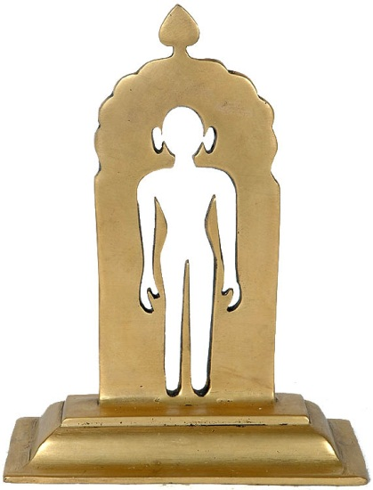
Sidhha Parmeshthi
They Have No Body
Reside in the Top most postion of the Teen-Lok- Sidhha Shila
Just Enjoy What they have attained – HAPPINESS
Difference Between Arihanta & Sidhha!!
# Arihanta have BODY But sidhha Don’t…
# Arihanta Give Divay-Dhwani But Sidhha Don’t…

Slide 4
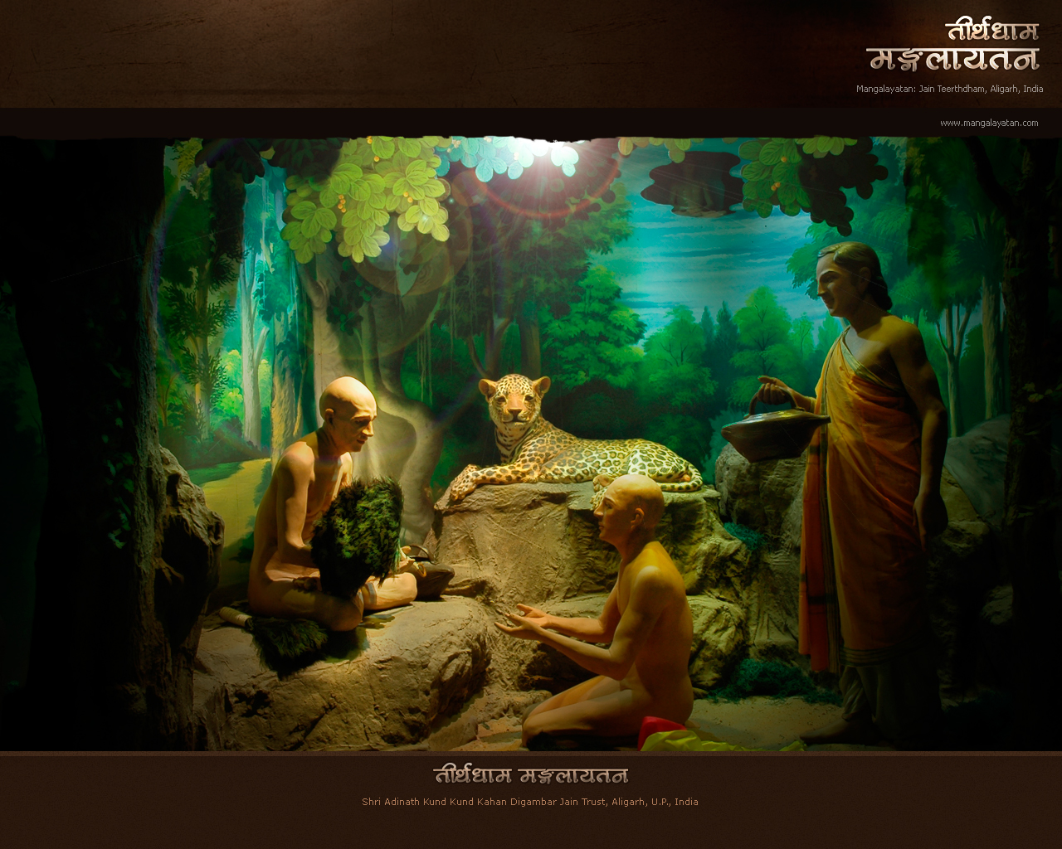
Acharya Parmeshthi
Monitor Sadhus/Monks
Guide Sadhus
Parmeshthi

Slide 5

Upadhyay Parmeshthi
Teaches Sadhus
Parmeshthi

Slide 6
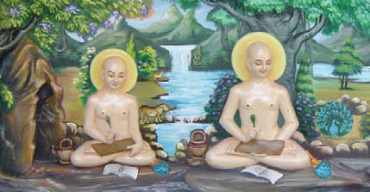
Sadhu
Parmesthi
(The monks)
Take preaching from Upadhyay
Parmeshthi
Take guidance from Acharya Parmeshthi
Practice the path of Liberation
– To attain their Goal
“True happiness”

Slide 7
Why Arihanta FIRST and Not Sidhha!!
No doubt,
Sidhha Bhagwan HAVE
No Body
Destroyed all the 8 karmas
Attained Pure Happiness
But we can NOT see them.
They DON’T
Give us Divya Dhwani
Show us path of Liberation

Slide 8

On the Other Hand, Arihanta bhagwan
Have Body.
Give us the DivyaDhwani (Jin-Vani).
Show us path of Liberation.
Are an example for us to attain complete bliss.
THEREFORE WE PAY SALUTATIONS TO ARIHANTAS FIRST..
But there is nothing like Arihantas are more adorable and Sidhhas are less.
No. They both have attained the Salvation and therefore are equally adorable and Ideal for us to walk on Path of Liberation.

Slide 9
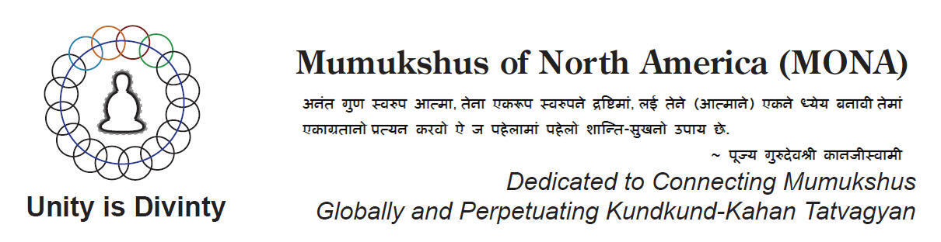
atmarthi608@gmail.com

