Slide 1


Let’s Learn About The Great Souls…
Parmeshthis…
How Are They??

Slide 2
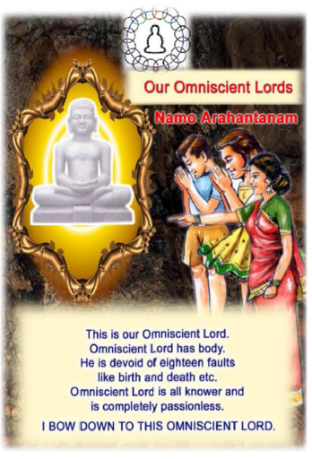

Slide 3


Slide 4
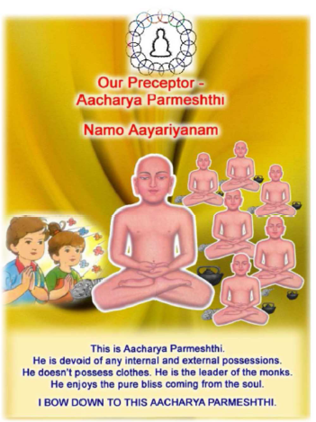

Slide 5


Slide 6


Slide 7
Namokar Mantra :
Word Dictionary
Parmeshthi – Top Most Position
Dev = Veetragi + Sarvagya + Hitopdeshi
Veetragi – Whose Attachments Have gone away.
Sarvagya – Who knows Everything
Hitopdeshi – Gives Divya-Dhwani/Preaches Us.
Guru – Completely Detached, Disregarding all Worldly possessions.

Slide 8
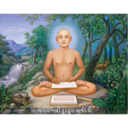
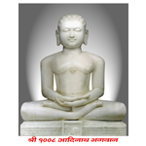
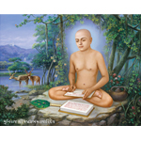

Dev & Guru
Chart I
Five Parmeshthi
DEV GURU
# Arihant Bhagwan # Siddha Bhagwan * Upadhyay * Acharaya * Sadhu

Slide 9
Namokar Mantra :
Facts
Namokar Mantra :
Has 35 Words & 57 Vowels
Has FOUR other names :
Maha-Mantra [As it salutes to GREATEST (Maha) positions]
Mool Mantra [As it is the ROOT (Mool) of all the Mantras]
Anadi-Nidhan Mantra [Because it has NO Beginning (Adi) & NO End (Ant)]
Panch-Namaskar Mantra [As it pay Salutations (Namaskar) to Five (Panch) Parmeshthis]
Was First written in the Scripture – Shat Khandagam – as Benediction (Mangalacharan) of it - By Aacharya Pushpdant & Aacharya Bhootbali

Slide 10
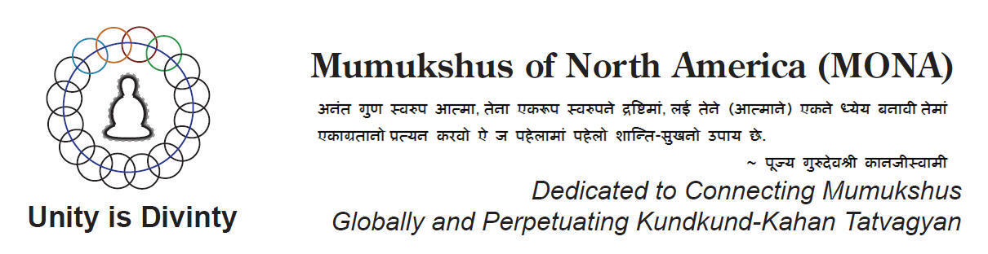
atmarthi608@gmail.com

