Slide 1

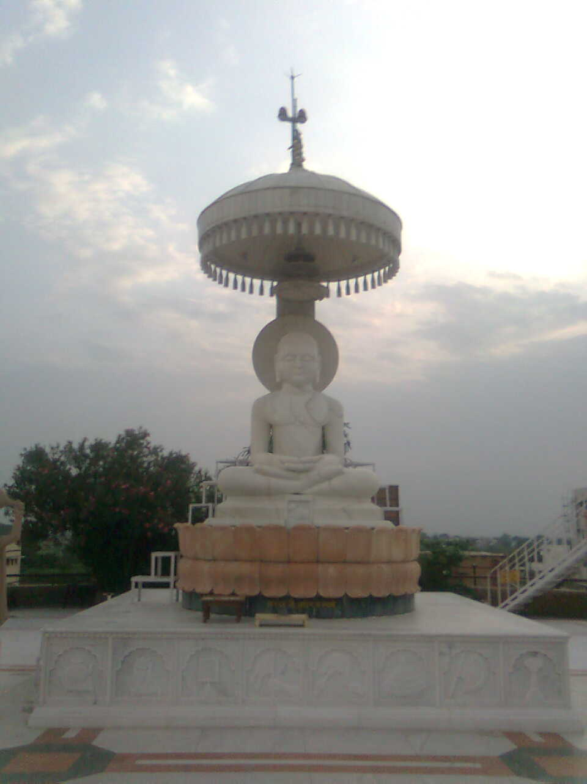
DEV DARSHAN

Slide 2
Getting Ready For Dev-Darshan!
Wake-up early in the Morning.
Get ready (Brush your teeth/Cleanse yourself/take bath etc.)
Put on Clean Clothes.
Take Clean Dravya (Substance to be gifted to Lord/Dev)
Leave for the Holy Temple.

Slide 3
Reaching The Holy Temple
Put Off the Shoes/Chappals at the Gate of Temple.
Make sure you take NO Leather Objects (Belt, Purse etc.) inside the temple.
Wash Your Hands & Feet at the Gate of Temple where Water is kept for the purpose.

Slide 4
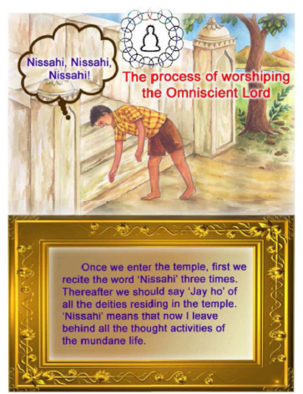

Slide 5
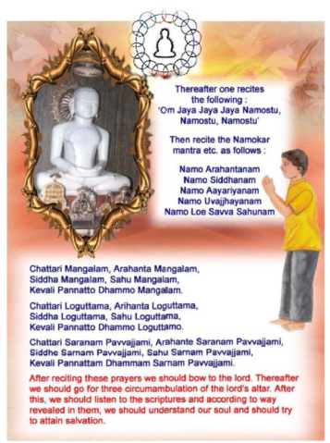

Slide 6
What Is The Good Of All This?
Dev Darshan –
Brings Peace to the Soul
Purifies Our Thoughts
We talk about OUR Soul in the Temple. If We understand our Soul & dive deep into it, WE CAN OURSELVES ATTAIN GODHOOD!!!

Slide 7

Aaa
atmarthi608@gmail.com
atmarthi608@gmail.com

