Slide 1
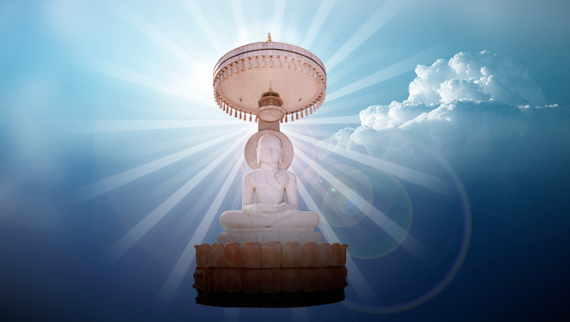
Dev - Stuti
The Prayer…

Slide 2
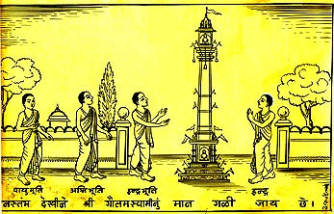

Oh God! Devoid of Attachments
Omniscient, our well-being preacher
Let our wrong belief get destroyed,
By Knowledge sun, fulfill Prayer.

Slide 3

May we be kind to all souls,
And never speak the untruth
May we never do stealing?
May we all practice celibacy!

Slide 4


Let not raise our Pride and Greed,
May we drink satisfaction nectar
May we always keep serving,
Our Jain Religion so divine!

Slide 5
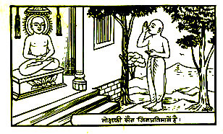
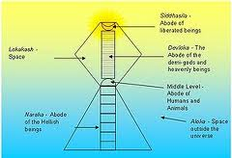
May we eliminate bad practices,
And spread good pleasing deeds
May we live happily with others,
Propagating our triumphed religion!

Slide 6

In rich joys and gloomy sorrows
As Mountains May we stay composed,
May we always tread the path of
Righteousness concentrating on our soul!

Slide 7
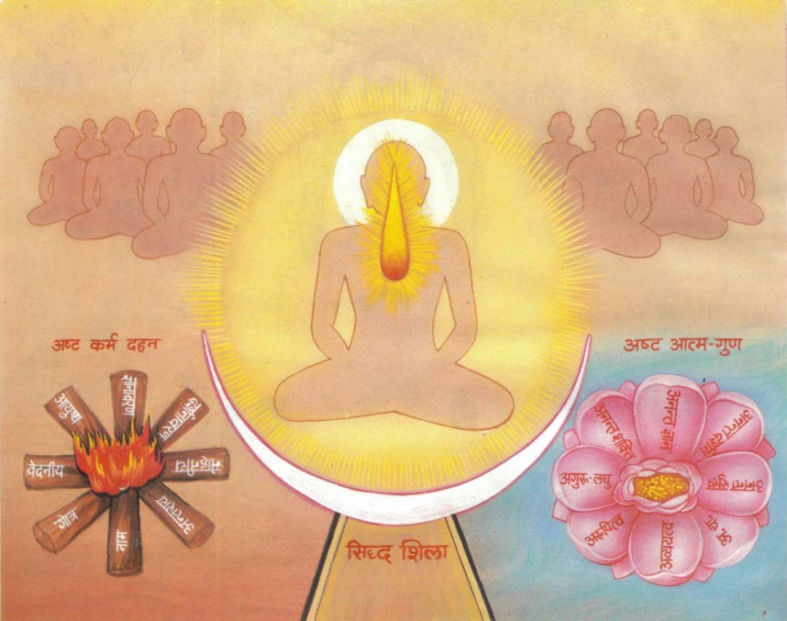
May we destroy Eight Karmas,
That lead to unhappiness in the world
May we keep uttering Your name,
O Lord! That destroys all Troubles!

Slide 8
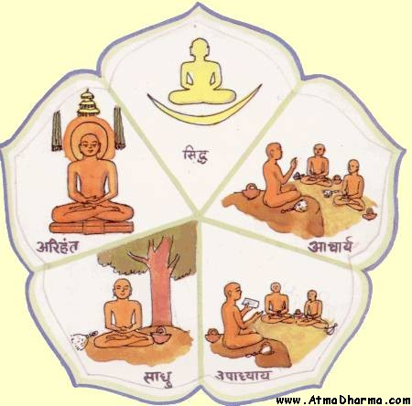
May our souls remain untainted
Deprived of the dust of all sins
Let true knowledge of ourselves
Grow within, with religious education!

Slide 9
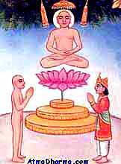
Standing on our feet, With Joined hands,
We worship Thee, oh dear Lord!
And pray that all our hopes,
Be fulfilled, we attain ourselves!

Slide 10
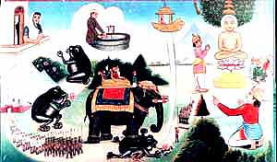
Oh God! Devoid of Attachments
Omniscient, our well-being preacher
Let our wrong belief get destroyed,
By Knowledge sun, fulfill Prayer.

Slide 11


