Slide 1

Jeev & Ajeev

Slide 2
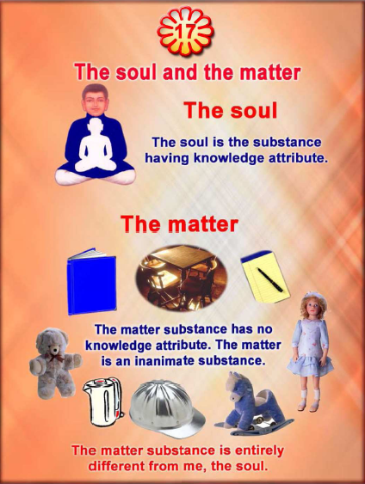

Slide 3
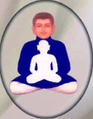
Who Am I?
I am Jeev.
I have Knowledge Attribute (Gyaan Gun).
I Know by this Knowledge Attribute.

Slide 4
Let’s Revise :
WHO ARE YOU?
              JEEV! JEEV!! JEEV!!!
WHAT DO YOU HAVE?
              GYAN! GYAN!! GYAN!!!
WHAT DO YOU DO?
              WE KNOW! WE KNOW!! WE KNOW!!!

Slide 5
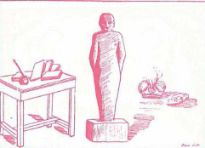
What is Body?
Body is Ajeev.
It does not have Knowledge Attribute (Gyan Gun).
It Knows Nothing.

Slide 6
Let’s Revise :
WHO IS THE BODY?
                AJEEV! AJEEV!! AJEEV!!!
DOES IT HAVE GYAN?
                NO! NO!! NO!!!
DOES IT KNOW?
                NO! NO!! NO!!!

Slide 7
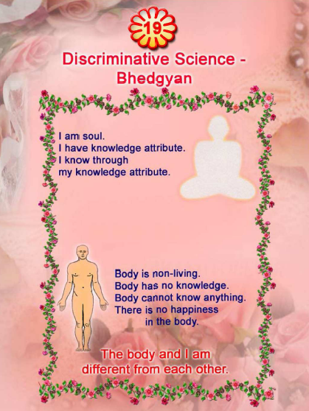

Slide 8
IS BODY YOURS?
D
I
S
C
O
V
E
R
I
E
S
!
DO YOU PERFORM THE WORK OF BODY???
IF YOU ARE A JEEV, AN ANT IS WHAT?

Slide 9


