Slide 1

MY INTRODUCTION!!!

Slide 2

Pure Soul (Shudhh-aatam) is My Name,
Knowing alone is my fame.
The Salvation is my Home,
Filled with Perfect Bliss, my own throne!

Slide 3

No thirst or hunger reaches my Address,
No cough or cold is allowed in my Fortress!
Free from Agony and Hurt, nowhere to roam,
Real, exultant & supreme is my home…
My name is Pure Soul,
My fame is to know alone!

Slide 4
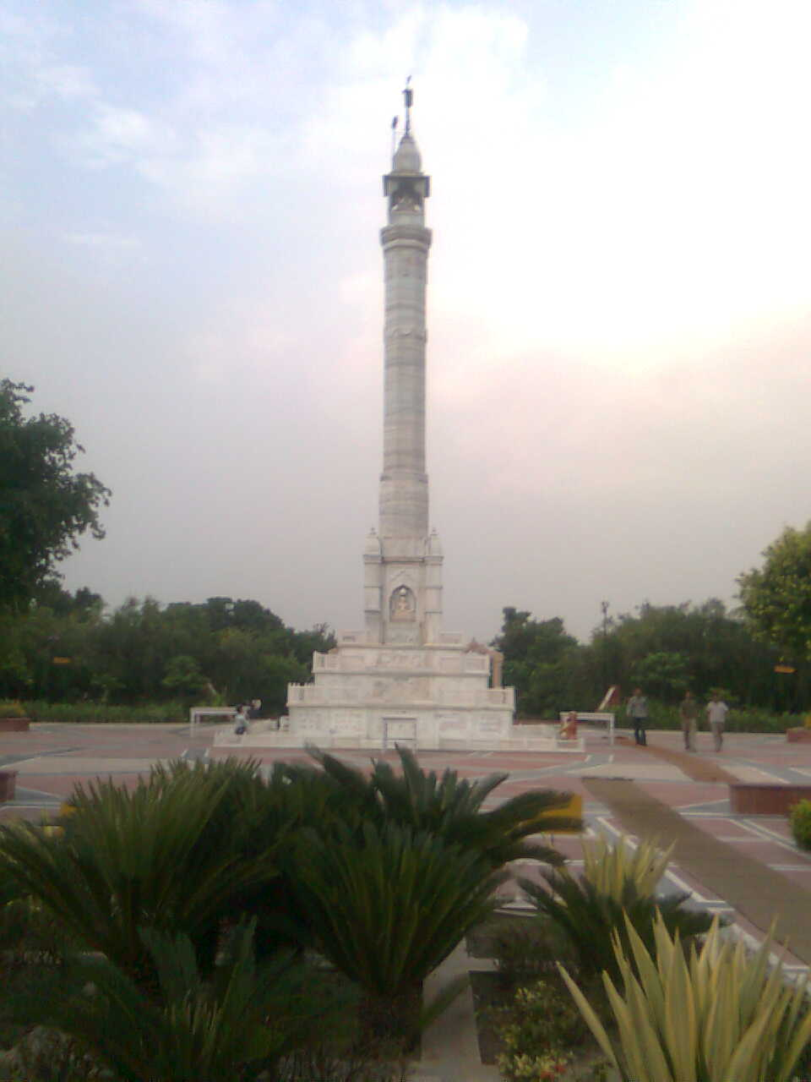
We shall Discriminate the self from others,
Meditate upon our soul and renounce worldly aversions!
We shall have the spiritual bliss,
My home is full of happiness…!

Slide 5
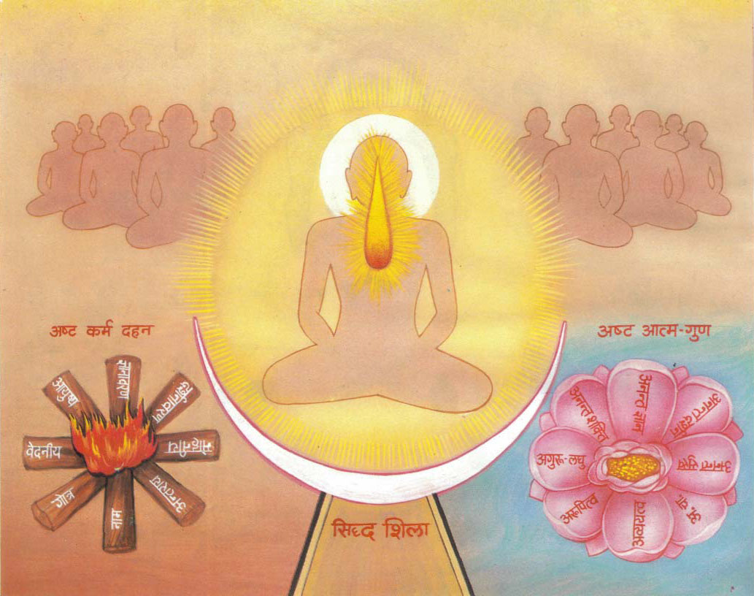
My name is Pure Soul.
My fame is to know alone!
The Salvation is my Home,
Filled with Perfect Bliss, my own throne!

Slide 6


