Slide 1
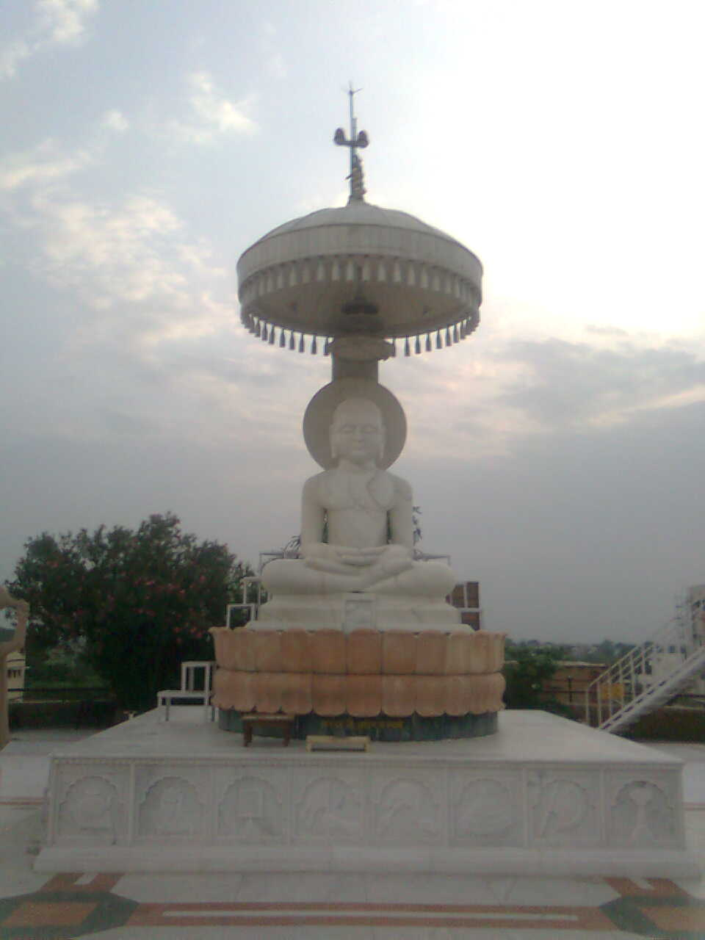

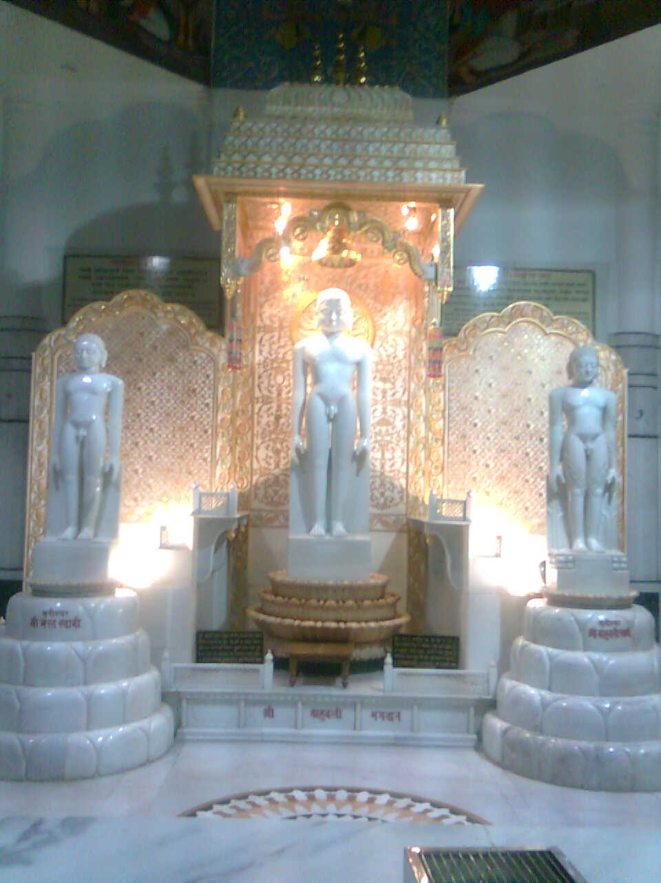
Teerthankar & Bhagwan

Slide 2
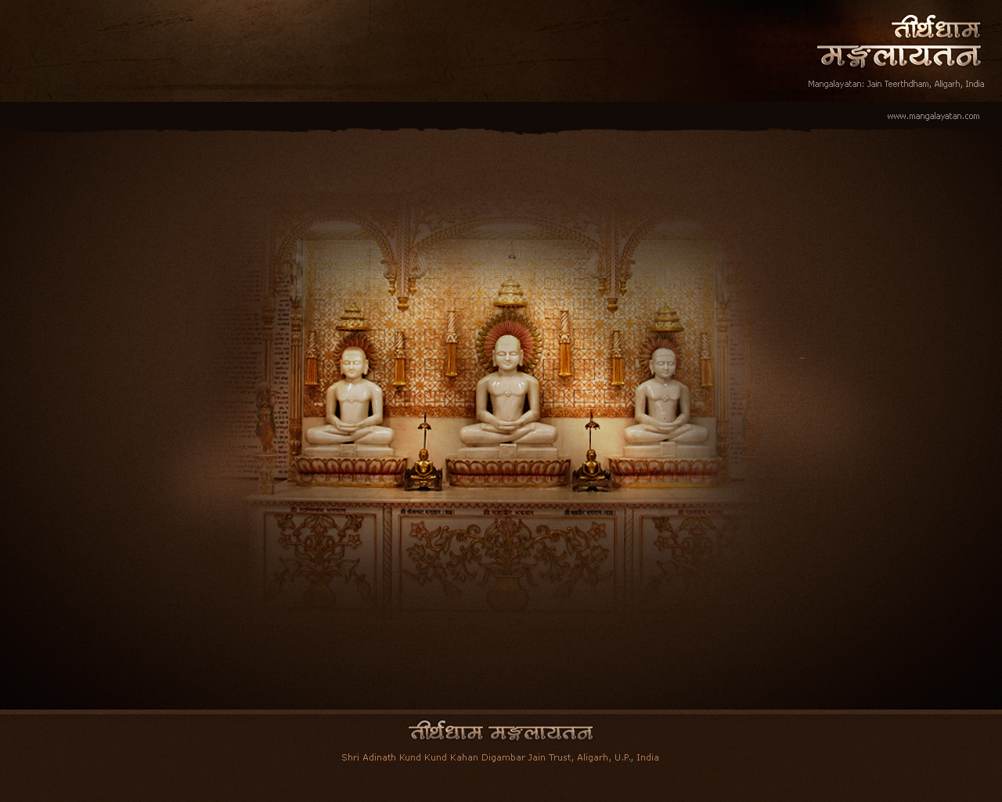
About Teerthankar :
Preaches the Right path to Liberation;
Is surrounded by the Magnificence of Samav- Sharan & other Glories;
In whom Teerthankar Naamkarma has come to
Fruition.
Are Twenty-Four in number.

Slide 3
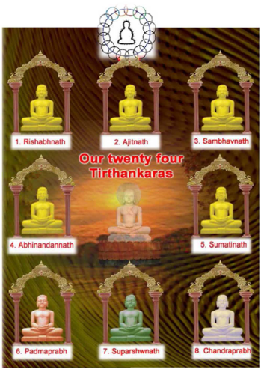

Slide 4
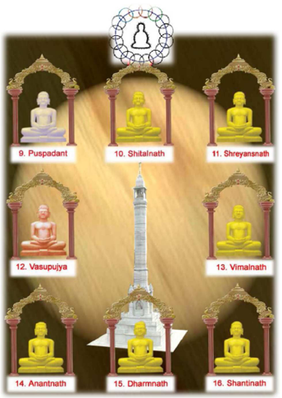

Slide 5
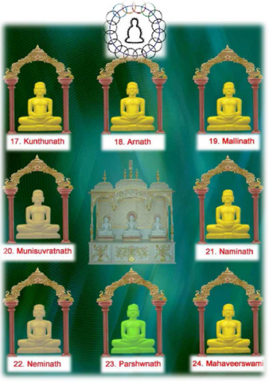

Slide 6
24 Teerthankaras : let’s learn their Names
Rishabh, Ajit, Sambhav, Abhinandan, Sumati, Padm, Suparshwa Jinray;
Chandra, Puhup, Sheetal, Shreyans Jin, Vasupujya Poojit Surray;
Vimal, Anant, Dharm Jas Ujjval, Shanti, Kunthu, Ara, Malli Manay;
Munisuvrat, Nami, Nemi, Parshwa Prabhu, Vardhman Pad Pushpa Chadhay…

Slide 7
Meanings/Full Names :
13 Vimal : Vimalnath
14 Anant : Anantnath
15 Dharm : Dharmnath
16 Shanti : Shantinath
17 Kunthu : Kunthunath
18 Ara : Arahnath
19 Malli : Mallinath
20 Munisuvrat : Munisuvratnath
21 Nami : Naminath
22 Nemi : Neminath
23 Parshwa : Parshwanath
24 Vardhman : Mahavir
1 Rishabh : Rishabh Dev
2 Ajit : Ajitnath
3 Sambhav : Sambhavnath
4 Abhinandan : Abhinandannath
5 Sumati : Sumatinath
6 Padm : Padmprabh
7 Suparshwa : Suparshwanath
8 Chandra : Chandraprabh
9 Puhup : Pushpdant
10 Sheetal : Sheetalnath
11 Shreyans : Shreyansnath
12 Vasupujya : Vasupujya

Slide 8
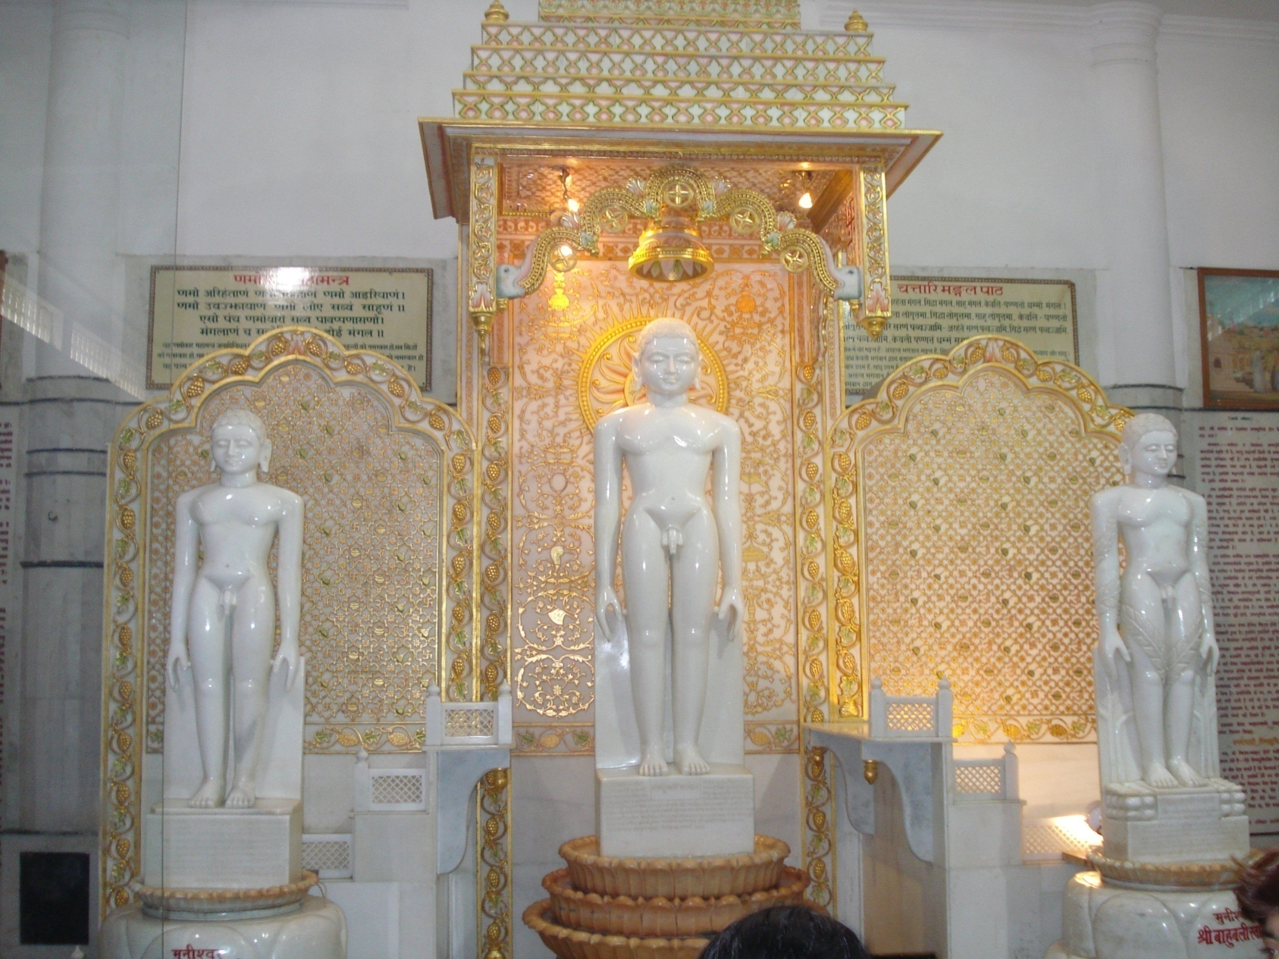
About bhagwan
Are free from Attachments (Veetragi);
Are Omniscients (Sarvagya).
Are Infinite in number.

Slide 9
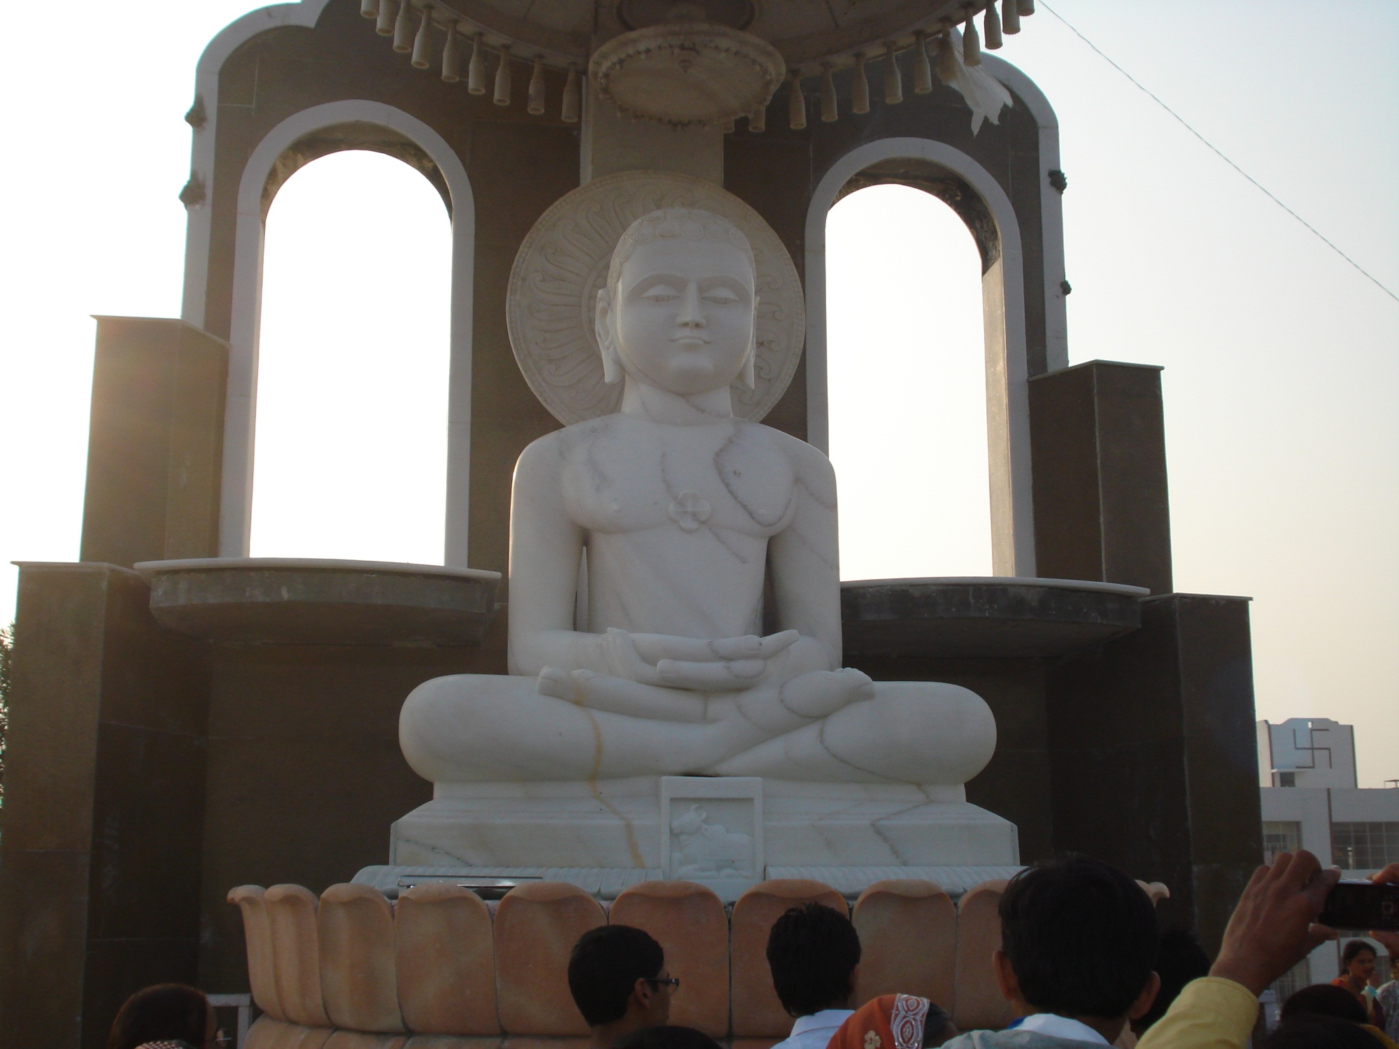
TEERTHANKAR & BHAGWAN
Difference

Slide 10

Teerthankar
Have Symbols (Chinha).
Bhagwan
Divine sound of Bhagwan is NOT compulsory.
Do not have Symbols (Chinha).
Have Divine Sound (Divya-Dhwani).

Slide 11
Teerthankar
Are TWENTY FOUR (24).
All Teerthankaras are Bhagwan.
Bhagwan
Are INFINITE.
All Bhagwans are not Teerthankaras.

Slide 12

Teerthankar
Have Panch Kalyanak
One can attain Happiness without being Teerthankar.
Bhagwan
Do not have Panch Kalyanak.
One can not attain happiness without being Bhagwan.

Slide 13

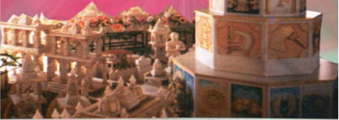
Teerthankar
Have Samav-Sharan.
To become Teerthankar is result of VIRTUE.
Bhagwan
Do not have Samav-sharan.
To become Bhagwan is result of Dharma.

Slide 14
What is the good of knowing this?
  This gives us the confidence that WE can ourselves ATTAIN Godhood by Understanding Teerthankars’/Bhagwans’ Teachings and Practicing them…

Slide 15
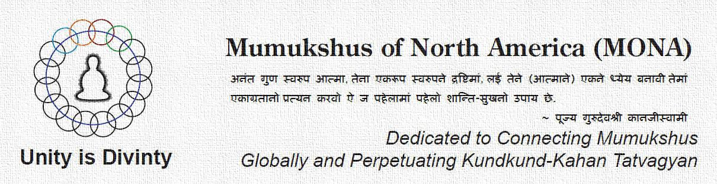
atmarthi608@gmail.com

