Slide 1

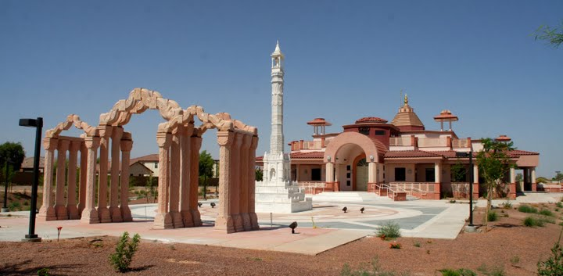

Astaprakari Pooja
Worship with eight auspicious substances’ offering.

Slide 2
POOJA – WHY ?
Pooja is one aspect of religious devotion.
Every religion including Jains have different ways to express devotion.
We perform pooja to remember and respect the qualities of liberated soul (Tirthankars) and
acknowledge that Tirthankars were people like us who followed the path of liberation to achieve Nirvana.
We do not expect any material things in return, but wish to achieve the ability to follow the path of liberation.

Slide 3
Pooja – How ?
Preparations for pooja:
Shower and get ready.
Put on the clean clothes.
Prepare for needed utensils and eight auspicious dravyas.
These activities direct our mind and body towards auspicious deeds.

Slide 4
Parts of pooja
1. Annointation -Abhishek – We pour pure
water over the statue and then dry the
statue with clean cloth.
2. Sing the value of Pooja and Namokar Mantra
3. Remembering 24 tirthankers.-Swasti
4. Invocation:
- feeling the presence of God with me
- feeling the presence of God in my heart
- feeling oneness with God
5. Pooja with eight auspicious dravyas.
6. Homage (Jaimala)
7. Peace Prayer(Shanti path)
8. Ending of Pooja (Visarjan)

Slide 5
EIGHT - DRAVYAS
1.JAL- Clean water:
Depicts ocean of knowledge. With right knowledge one can eliminate birth, suffering of old age and death.
we offer clean water to achieve right knowledge.

Slide 6
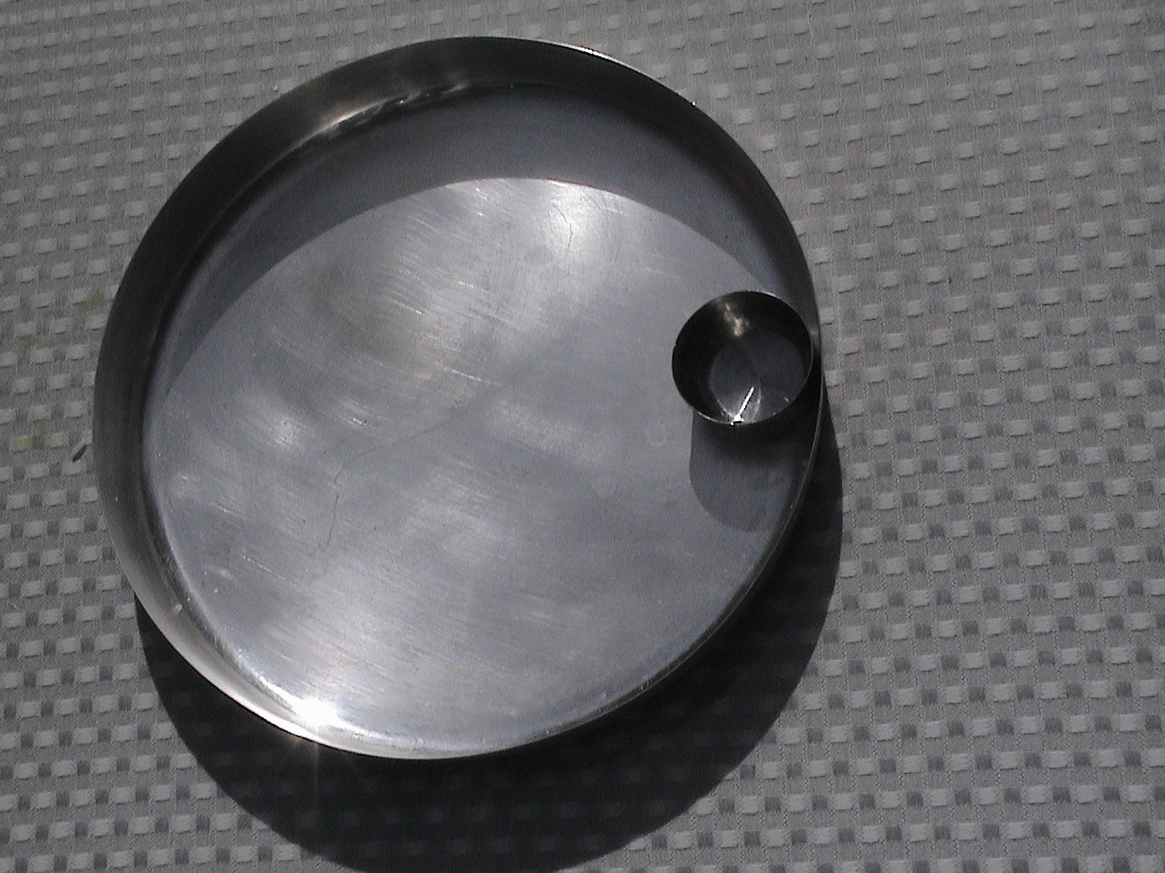

Slide 7
EIGHT - DRAVYA
2.CHANDAN – Saffron color water:
Depicts cure of suffering (Saffron wrapping is suppose to cure high fever
Real cure of suffering is right perception.
we offer saffron water to achieve right perception.

Slide 8
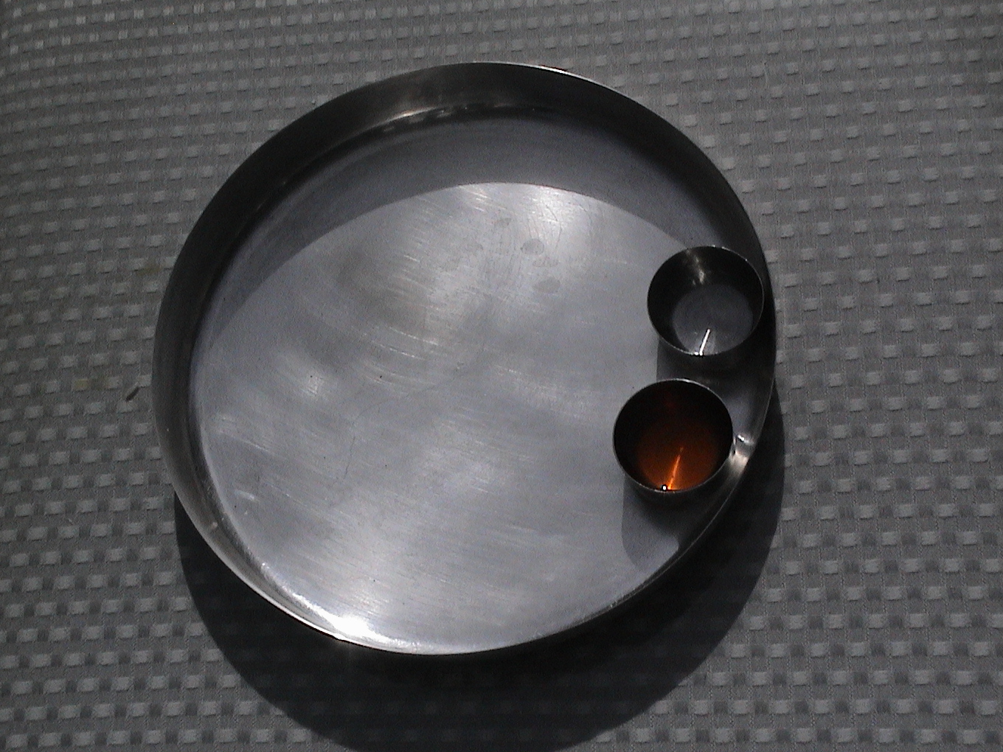

Slide 9
EIGHT - DRAVYAS
3.Akshat – unbroken white rice:
Depicts uninterrupted happiness which can be achieved by decreasing feeling producing karmas.
We thrive for this happiness by offering Akshat.

Slide 10
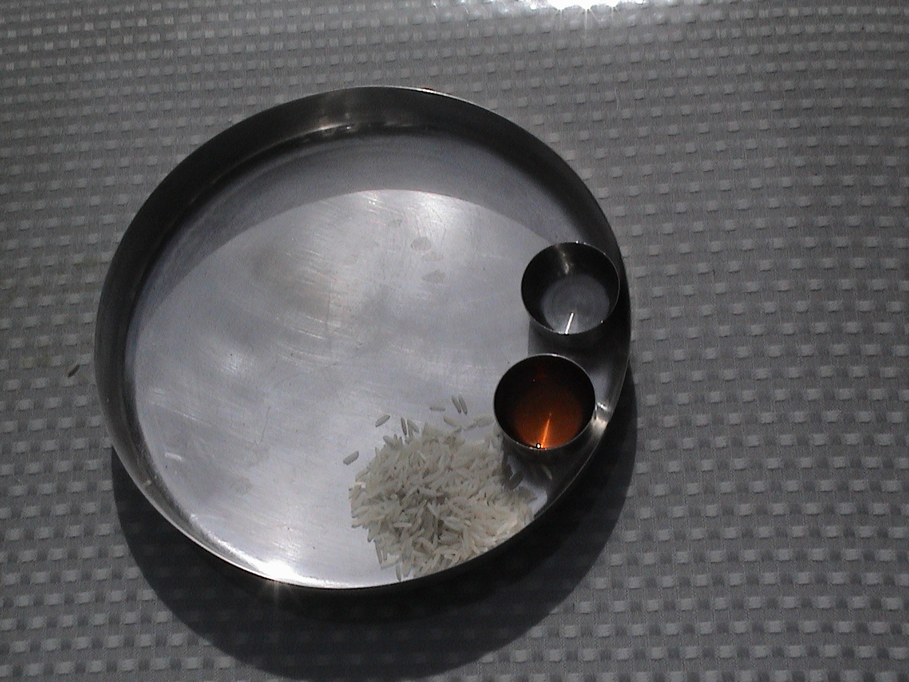

Slide 11
EIGHT - DRAVYA
4. Pushpa – Saffron color rice:
It depicts flowers (By not using real flower,we prevent violence).
Color and beauty of flowers deludes one to attractions.
We offer Pushpa to help rid of deluding karma.

Slide 12
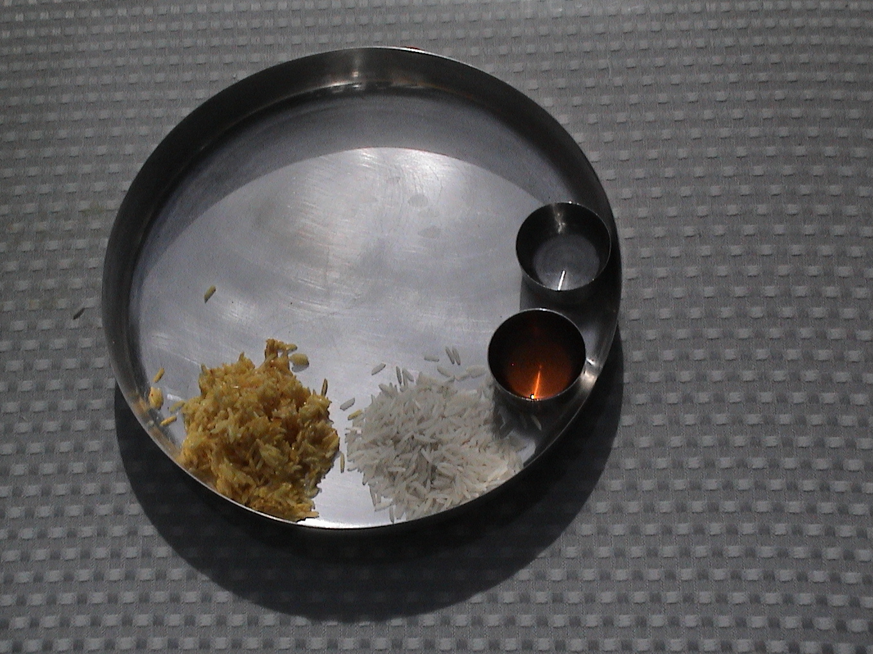

Slide 13
EIGHT - DRAVYAS
5.Naivaidya – white coconut:
Depicts food material. Food eliminates suffering from hunger and help extend the life.
We offer Naivaidya to eliminate age determining karma.

Slide 14
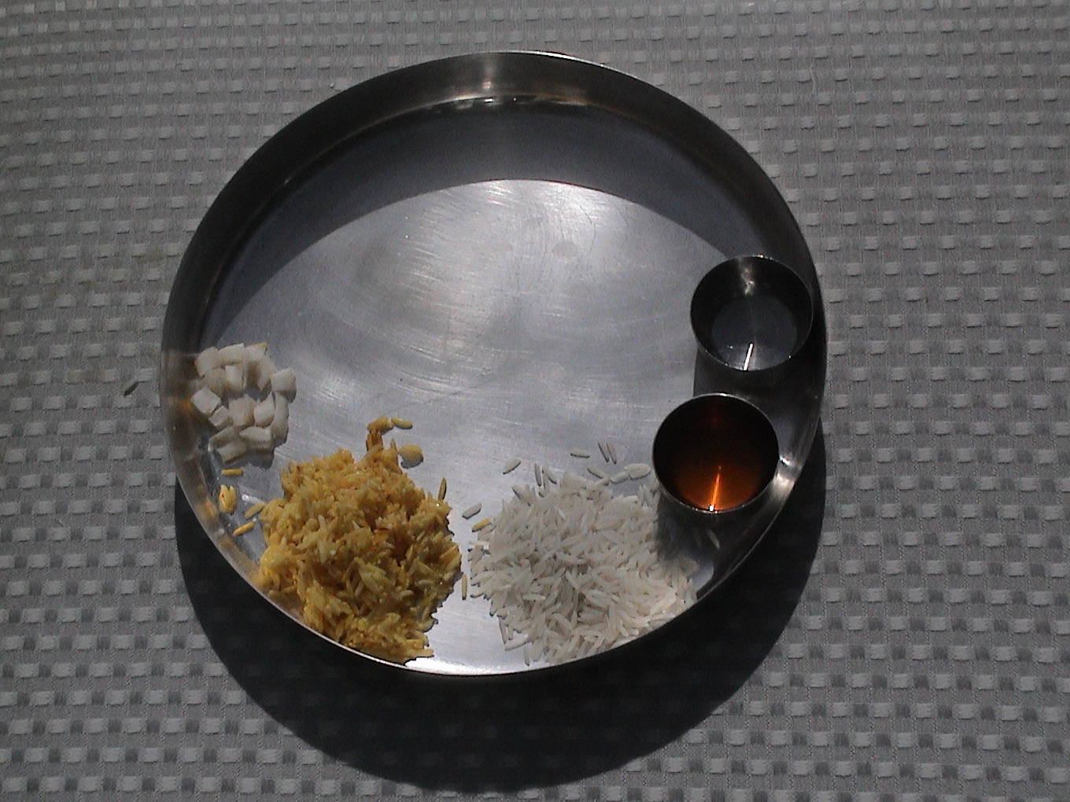

Slide 15
EIGHT - DRAVYAS
6.Deep – Saffron colored coconut:
Depicts light .Light let us see every thing obvious on the out side like shape, size, color etc.
We wish to see the qualities of our soul inside.
We offer Deep to rid of name determining karma.

Slide 16
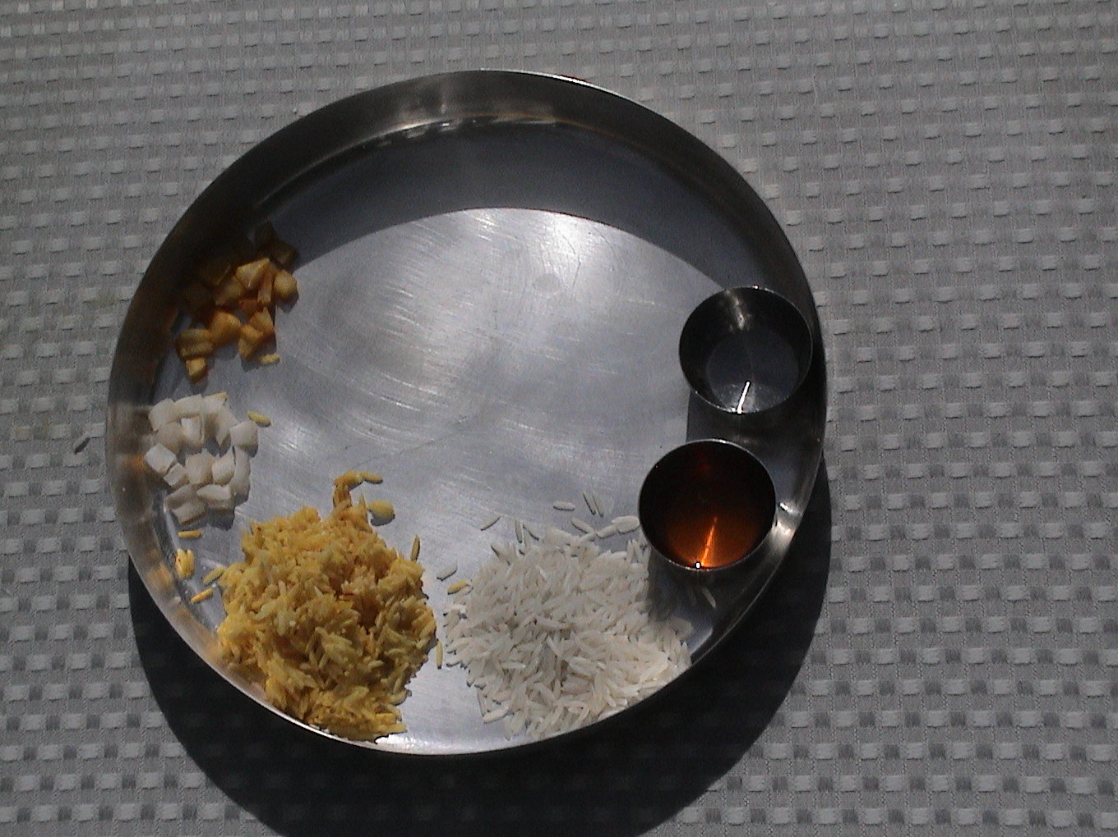

Slide 17
EIGHT - DRAVYAS
7.Dhupa – Smell of incense:
Smell of incense can reach all directions and all heights.
we wish to eliminate feeling of inequality of status.
we offer incense to get rid of status determining karma.

Slide 18
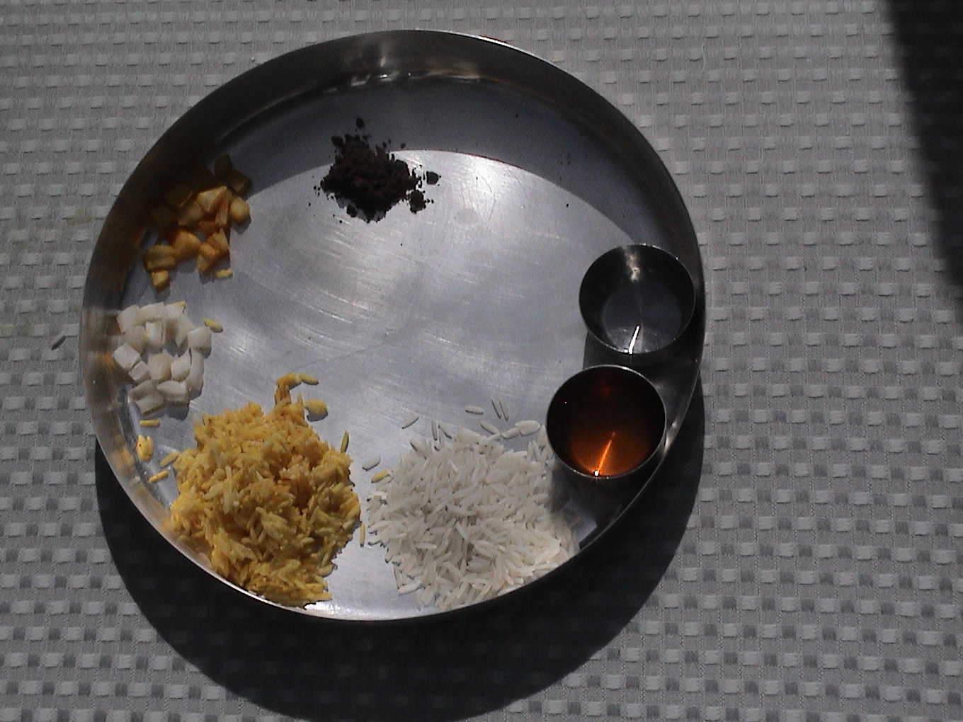

Slide 19
EIGHT - DRAVYAS
8.Phal – almond:
Phal means results.
Results of obstructing karma lead to obstructions of the powers of soul.
We offer Phal to grow uninterrupted powers of soul to achieve Moksha.

Slide 20
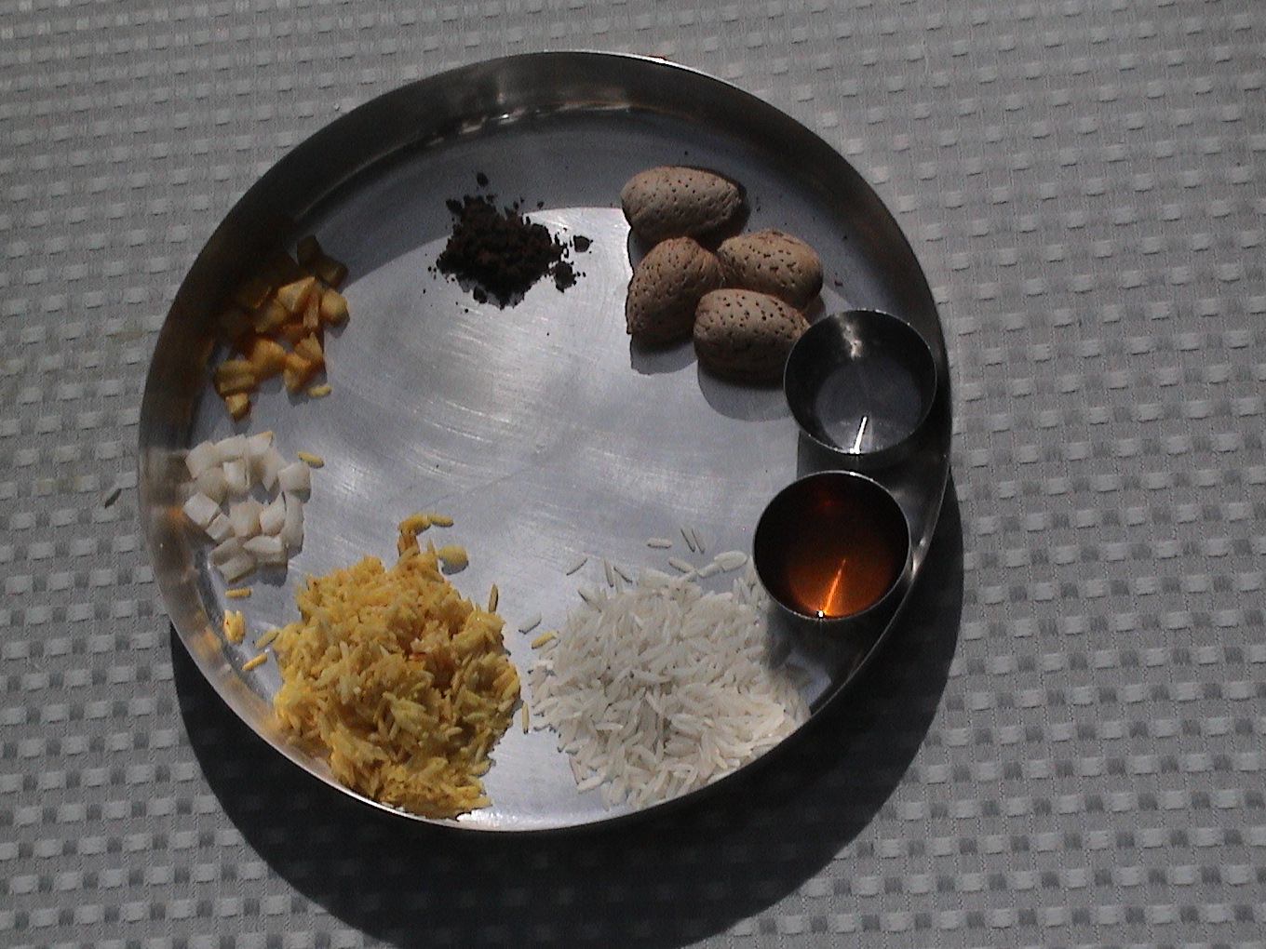

Slide 21
EIGHT – DRAVYAS
9.Argha – Mixture of all eight dravyas:
Total result of all the eight offerings.
we wish to rid of all eight type of karmic particles.
we offer Argha to thrive for eight qualities of Siddha.

Slide 22
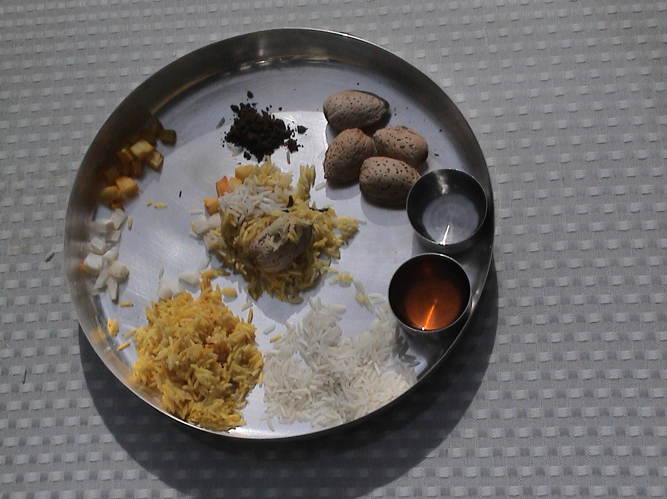

Slide 23
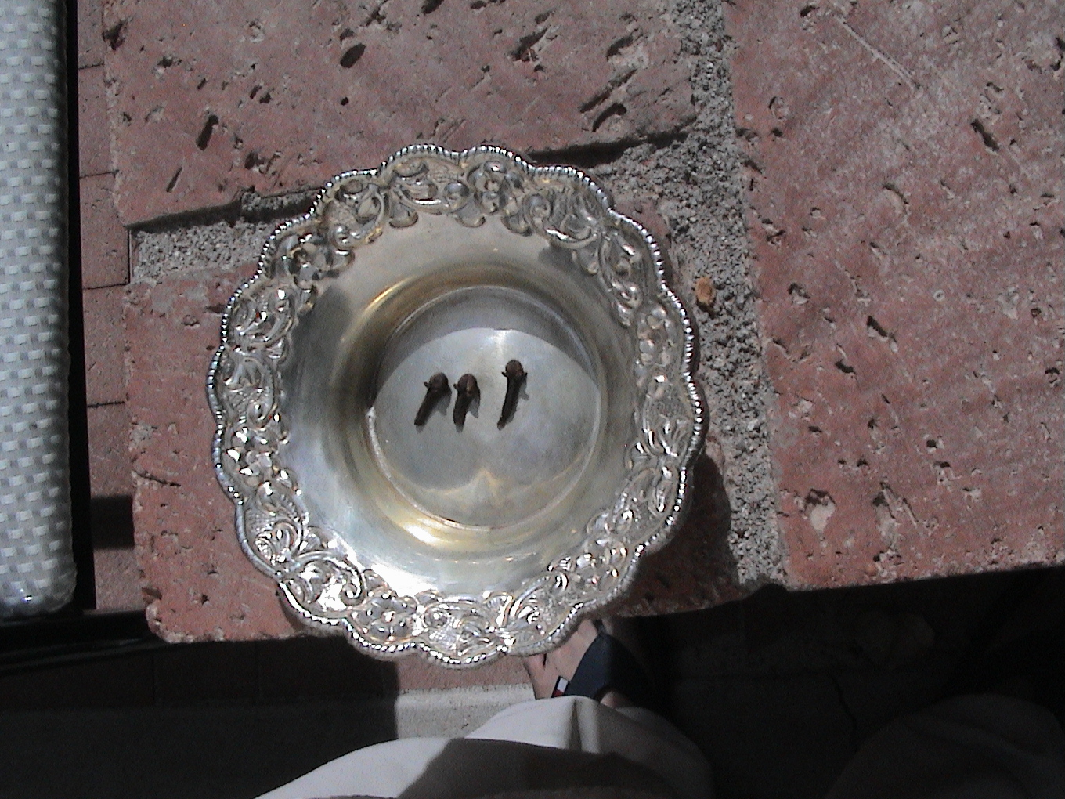

Slide 24
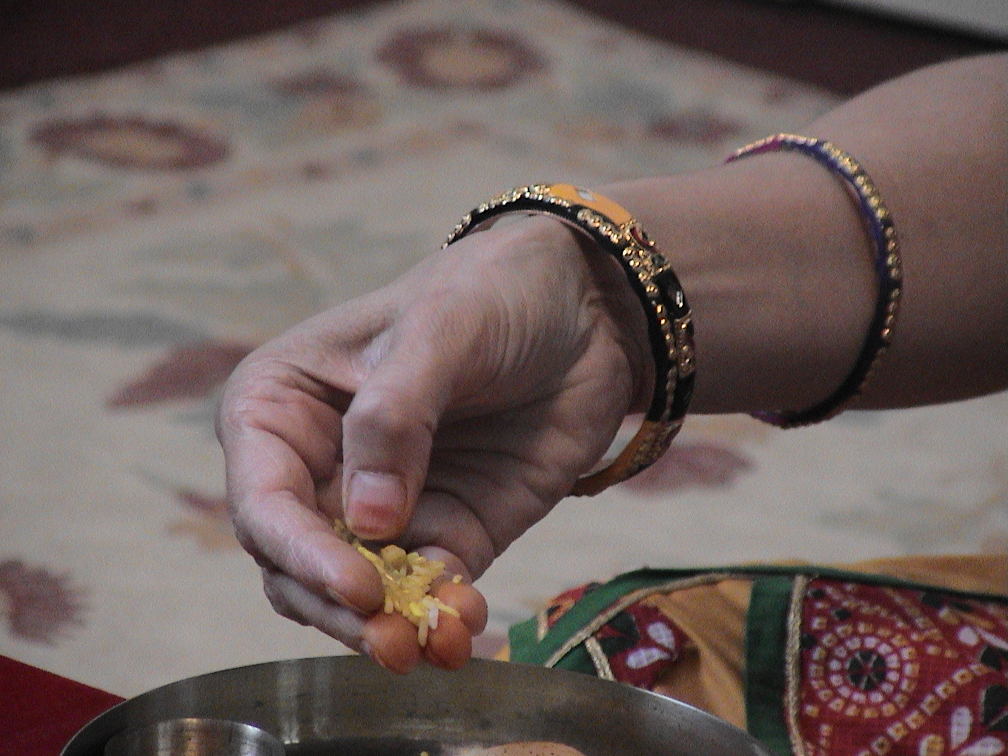

Slide 25
Eight auspicious substances.
Jal-Pure water
Chandan-Sandlewood
Akshat-Rice
Pushp-Flower
Naivedya-Rich food
Deep-Flame
Dhup-Insense
Fal-Fruit

Slide 26
Darshan stotra
Next set of stanzas are to be recited when we go to the temple to worship the god.

Slide 27
Darshan Stotra
Darshanam Deva Devashya Darshanam Pap Nashanam
Darshanam Swarg Sopanam Darshanam Moksha Sadanum
By bowing to the god my sins wash away, I obtain heaven and
ultimately I will obtain The nirvana- The moksha

Slide 28
Darshan Stotra
Darshanen Jinen dranam Sadhunam Vandene Na Cha
Na Chiram Tisthathe Papam Chhidra Haaste Yasho Dakam
By not bowing to my supreme lord and not paying my respect
to the enlightened monks I am not able to wash away my sins
and my fame also go away.

Slide 29
Darshan Stotra
Vitrag Mukhum Drastva Padma Raga Sama Prabham
Janma Janma Krutum Papum Darshanena Vinashyati
By observing the face of my omniscient lord my billions of
likes and dislikes go away and my sins of many previous
lives also go away

Slide 30
Darshan Stotra
Darshanam Jin Suryasya Sansar Dhwanta Na Shanam
Bodhanam Chitta Padmasya Samastartha Prakashanam
My lord is like the sun, whose effect removes the darkness
of transmigration and my entire heart lights up with his
spiritual advise.

Slide 31
Darshan Stotra
Darshanam Jin Chandrasya Sad dharma Mruta Varshanam
Janma Daha Vinasaya Vardhanam Sukha Varidhe
My lord is like the moon who gives me the nectar of right
religious principles.As a result of it my pains of life and
death cycle go away and my inner happiness increase
immensely.

Slide 32
Darshan Stotra
Jivadi Tatva Pratipada Kaya Samyaktva Mukhiyast Gunarnavaya
Prasant Rupaya Digambaraya Devadhi Devaya Namo Jinaya
You have shown the living etc. nine reals and the eight parts of
enlightened faith. My lord you are with divine peace, and has no
possessions. You are the greatest of the great lord. I bow down to
you.

Slide 33
Darshan Stotra
Chidanandake Rupaya Jinaya Paramatmane
Paramatma Prakashaya Nityam Siddhatmane Namaha
O lord,you are shinning with pure knowledge and absolute
happiness. By paying respect to you forever I am also able
to find my pure soul

Slide 34
Darshan Stotra
Anyatha Saranam Nasti
Tvameva Saranam Maamaah
Tasmat Karunya Bhavena Raksha Raksha Jineshvara
Now I do not seek shelter from any one but you. O lord,
you are full of compassion. Please give me refuge at your
feet.

Slide 35
Darshan Stotra
Nahi Trata Nahi Trata Nahi Trata Jagatraye
Vitragat Paro Devo Na Bhooto Na Bhavisyati
I see no protection from upper, middle and lower worlds.
Vitragi dev-the passionless lord, I know that I can get
refuge at your feet forever.

Slide 36
Darshan Stotra
Jiner Bhakti Jiner Bhakti Jiner Bhakti Dine Dine
Sada Mestu Sada Mestu Sada Mestu Bhave Bhave
O lord, I wish to perform the Jin prayer daily in this life and
lives beyond.

Slide 37
Darshan Stotra
Jin Dharma Vinir Mukto Ma Bhava Chakra Vartyapi
Syatche Topi Dari Dropi Jin Dharmanu Vasi Taha
Some living being are without the shelter of Jain religion for
life long Their life is devoid of absolute truth and the
fragrance of Jain philosophy.

Slide 38
Darshan Stotra
Janma Janma Krutam Papum Janma Koti Mupar Jitam
Janma Mrutyu Jara Rogam Hanyate Jin Darshanat
I did innumerable sins forever. As a result I got involved in
to the transmigratory cycle so far. Now I realize that by
worshiping the lord Jina in proper form I can destroy my
misery of life and death cycle.

Slide 39
Darshan Stotra
Adya Bhavat Safalata Nayana Dwayasya
Devatwa Diy Charanam Buja Viksha Nena
Adya Triloka Tilakam Pratibha Sate Me
Sansar Varidhi Rayam Chulaka Pramanam
O lord, by observing your lotus feet with my external as well
internal eyes, now I feel that my life is fulfilled. I can now
see that the three worlds of universe are like an imaginary
story and the ocean of transmigratory life is like a small
verse of the story.

Slide 40
Vinay Path
Vinay means respect. When we know the qualities of the lord, then the respect comes automatically. Here we recite the poem and express our gratitude to the Omniscient lord.

Slide 41
Vinay Path
Ih Vidhi Thado Hoike Pratham Padhe Jo Paath
Dhanya Jineshvar Dev Tum Nase Karma Joo Aath
O Jineswar dev, with proper ceremony when I establish
you in my heart and recite the religious hymns, then my
eight karma go away.

Slide 42
Vinay Path
Anant Chatushtya Ke Dhanee Tum He Ho Sirtaj
Mukti Vadhoo Ke Kanth Tum Tine Bhuvan Ke Raj
You are the owner of the infinite pure attributes. You have
freed your self. You are the king of the entire universe.

Slide 43
Vinay Path
Tee Hu Jag Ki Pida Haran Bhava Dadhee Shoshan Haar
Gnayak Ho Tum Vishva Ke Shiv Shukh Ke Kartar
You are able to remove the misery of life and death cycle of
upper, middle and lower worlds and help the mundane soul
to obtain the everlasting happiness

Slide 44
Vinay Path
Harta Agha Andheeyar Ke Karta Dharma Prakash
Thirta Pad Datar Ho Dharta Nij Gun Raas
You are the remover of the darkness of sins and give the
light of religion. You give us the equanimity and show us
our own pure attributes.

Slide 45
Vinay Path
Dharma Mrut Oor Jal Dhi Sho Gnan Bhanoo Tum Roop
Tum Re Charan Saroj Ko Navat Teehoon Jag Bhoot
Your heart is full of nectar of religion, your beauty is
shinning with pure knowledge and at your feet there are
lotus flowers. O lord, the great kings are coming to take
refuge at your feet.

Slide 46
Vinay Path
Me Vando Jin Dev Ko Kar Atee Nirmal Bhaav
Karma Bandh Ke Ched Me Aur Na Kachoo Upav
Therefore I worship you with my pure heart. I am submitting
to you without any doubt. I see no other way out of my
bonded karma.

Slide 47
Vinay Path
Bhavee Jan Ko Bhav Koop Tain Tum Hee Kadhan Haar
Din Dayal Anath Patee Atam Gun Bhandaar
You are full of compassions and helping the needy. You
are full of infinite pure attributes. You help the mundane
soul to come out of his intense pains of life and death cycle.

Slide 48
Vinay Path
Chida Nand Nirmal Kiyo Dhoi Raj Kar Mail
Saral Kareeya Jagat Me Bhavee Jan Ko Shiv Gail
You showed the path to the mundane souls to wash the
dirty karmic dust and to clean their impure soul. You made
the process extremely easy for us.

Slide 49
Vinay Path
Tum Pad Pankaj Pooj Tei Vighn Rog Tar Jaaye
Shatru Mitra Ko Dharey
Vish Neer Veeshta Thaay
By praying at your lotus feet, anybody’s difficulties go
away. Enemies with poisonous nature become true friends.

Slide 50
Vinay Path
Chakri Surkhaga Indra Pad Milai Aapte Aap
Anukram Kar Shiv Pad Lahe
Nem Sakal Hani Pap
Rulers of six areas-chakravarties, people with special
power to fly, and the king of the angels, they all accept your
supremeness. They follow the path shown by you and
obtain the Moksha.

Slide 51
Vinay Path
Tum Vin Me Vyakul Bhayo Jaise Jal Vin Min
Janma Jara Meri Haro Karo Mohee Swadhin
O lord, without you, I am restless just like the fish out of
water. Please give me the courage so I can follow the path
shown by you and can destroy my misery of life and death
cycle.

Slide 52
Vinay Path
Patit Bahoot Pavan Kiye Ginti Kaun Karev
Anjan Se Tare Kudhi Jay Jay Jay Jin Dev
As owl can see with collyrium in his eyes, the same way
with your refuge, countless souls have been liberated. O
lord, salutation to you.

Slide 53
Vinay Path
Thaki Nav Bhav Dadhi Vishe Tum Prabhu Par Karey
Khevatiya Tum Ho Prabhu Jay Jay Jay Jin Dev
My boat is in trouble in the middle of this trasmigratory
ocean. O lord, you are now the skipper of my boat. O lord,
salutation to you.

Slide 54
Vinay Path
Rag Saheet Jag Me Rulyo Mile Saragi Dev
Veet Rag Bhetyo Abein Meto Rag Kutev
Until now I was involved with passionate deities. As a result
I am full of passions. Now that I met the passionless god,
my passions are all gone.

Slide 55
Vinay Path
Kit Neegod Kit Narki Kit Tiryanch Agnan
Aaj Dhanya Manush Bhayo Payo Jinvar Than
For many lives I was born in to the lowest form of life, the
hell and the sub humans. Now I am lucky that I am born in
to the human life. Now I know the path shown by you.

Slide 56
Vinay Path
Tum Ko Poojay Sur-pati Ahee-pati Nar-pati Dev
Dhanya Bhaagya Mero Bhayo Karan Lagyo Tum Sev
You are been worshiped by kings of angles, humans and
snakes. I am so fortunate that I also realized to start
serving you.

Slide 57
Vinay Path
Asharan Ke Tum Sharan Ho Niradhar Aadhar
Me Dubat Bhav Sindhu Me Kheo Lagao Paar
You defend the defenseless and help the helpless. I was
sinking in to the trasmigratory ocean and you saved me.

Slide 58
Vinay Path
Indra-deek Ganapati Thake Kar Beenti Bhagavan
Apno Virad Nihari Ke Kije Aap Saman
The angels and their king request the Jin Bhagwan that
please show the path of liberation, so we all can become
like you.

Slide 59
Vinay Path
Tumri Nek Su-drasti Tein Jag Ootarat Hei Paar
Ha Ha Dubyo Jaat Ho Nek Nihar Nikar
With your kind nature any worthy soul gets liberation. I am
fortunate that you helped me. I am so happy that I got
treasure of nirvana because of you.

Slide 60
Vinay Path
Jo Me Kaha-hoon Aur-so To na Mite urzar
Meri To Tonso Banee Tatein Karo Pookar
By accepting you, my life has turned around. I now can not
stop singing your praises.

Slide 61
Vinay Path
Vando Pancho Param Guru Sur-guru Vandat Jaash
Vighan Haran Mangal Karan Pooran Param Prakash
I bow down all five supreme beings and respect all my
spiritual teachers. I know that all my difficulties will
disappear and I will on the path of lighted path of the
Moksha.

Slide 62
Vinay Path
Chobi-sho Jeen Pad Namo, Namo Sharda Maay
Siv Mag Sadhak Sadhu Nami Rachyo Path Sukh Daay
At the end of this poem, I bow down to the feet of all 24
Tirthankars, the holy scriptures and my spiritual teachers

Slide 63
Vinay Path
In vinay path we recited the greatness of the Jineswar Bhagwan.
However I know that when I was spiritually ready then and then the Bhagwan’s discourses were helpful to me.
I purified my self with my own efforts.
But with knowledge and purity comes the attributes of the respect.

Slide 64
Beginning of the
Pooja Vidhi
Prior to start the Pooja, we recite certain verses and also pay our homage to the Tirthankar Bhagwans who are present in the temple as deities.

Slide 65
Beginning of the
Pooja Vidhi
Om Jaya Jaya Jaya Namostu Namostu Namostu
Namo Arihantanam Namo Siddhanam Namo Ayariyanam
Namo Uwajayanam Namo Lowe Sava Sahunam
Oh Rim Anadi Mul Mantrebhyo Namaha, Pushpanjali Kshipami

Slide 66
Beginning of the
Pooja Vidhi
Chattari Mangalam Arihanta Mangalam Siddha Mangalam
Sahu Mangalam Kevali Panotto Dhammo Mangalam
There are four auspicious things. They are Arihant, Siddha,
Monks and the Religion preached by Omniscient Lords.

Slide 67
Beginning of the
Pooja Viddhi
Chattari Logutama Arihanta Logutama Siddha Logutama
Sahu Logutama Kevali Panotto Dhammo Logutamo
There are four best things in the universe. They are
Arihant, Siddha, Monks and Religion as preached by
Omniscient Lords.

Slide 68
Beginning of the
Pooja Viddhi
Chattari Sharanam Pavajjami Arihante Sharanam Pavajjami
Siddhe Sharanam Pavajjami Sahu Sharanam Pavajjami
Kevali Pannattam Dhammam Sharanam Pavajjami
Therefore there are four things in the universe to take refuge.
They are Arihant, Siddha, Monks and Religion as preached by
Omniscient Lords.

Slide 69
Beginning of the
Pooja Vidhi
Om Namor Rate Svaha, Pushpanjali Kshipami.
(Offering of Yellow Rice)

Slide 70
Mangal Vidhan
Mangal means the one which destroy the sins and help obtaining the purity of the self.
Vidhan means to make the statement.
Here we recite few of the verses. We pray the god that our pooja should be completed without any obstruction and at the end our thought process should become pure.

Slide 71
Mangal Vidhan
Apavitraha Pavitrova Susti To Dusti To Piva
Dhyayet Pancha Namaskaram Sarva Papae Pramuchhyatey
If the person is clean or unclean, or if the place is good or
bad, but the recitation is done for the five supreme being,
then the sins always wash away.

Slide 72
Mangal Vidhan
Apavitraha Pavitro Va Sarva Vastha Gato Piva
Yaha Smaret Paramatmanum Sa Bahya Abhyantare Suchihi
Whether person is clean or unclean, or could be in any
condition, but when he recites the god, he becomes pure
internally and externally.

Slide 73
Mangal Vidhan
Aparajita Mantroyam Sarva Vighn Vinashanam
Mangale Shu Cha Sarve Shu Prathamam Mangalam Mataha
This Namokar mantra is undefeatable, and can destroy all the
ills, and is auspicious of all.

Slide 74
Mangal Vidhan
Esopancho Namo Yaro Savvapava Panasano
Mangala Lancha Savve Sim Padamam Hoyi Mangalam
This Namokar mantra is destroyer of all the sins and is
most auspicious.

Slide 75
Mangal Vidhan
Arha Mittyaksharam Brama Vachakam Parmestinam
Siddha Chakrasya Sadbijaum Sarva Taha Pranama Myahum
I bow down to the lord Arihants and lord Siddhas with my
mind, speech and body.

Slide 76
Mangal Vidhan
Karmastaka Vinir Muktam Moksha Lakshmi Niketanam
Samyaktvadi Gunopetam Siddha Chakram Namamyaham
I bow down to the Sidhdha, who have removed all eight
karma and who have achieved the right faith etc. and have
attained the ultimate nirvana. I meditate on Him and will
remove all karma.

Slide 77
Mangal Vidhan
Vighnoghah Pralayam Yanti Shakini Bhut Pannagah
Visham Nirvishata Yati Stuy Mane Jineshware
Puspanjali kshipet.
By reciting the Omniscient Lords, all our discomforts
disappeared, the fear for the ghosts and the snakes etc.
disappears and the poison becomes ineffective.
Offering of yellow rice to be done.

Slide 78
Jin Shahasranam Argh
Uddaka Chandana Tandula Puspa Kayis Charu Sudip Sudhupa Falardhake
Dhavala Mangala Gana Rava Koole Jina Grahe Jina Nath Maham Yaje
Om Rim Shri Bhagvat Jina Sahasraname Bhyo
Argham Nirvi Pamiti Swaha
I am offering the eight auspicious materials to thousands of Omniscient Lords.

Slide 79
Swasti Mangal Path
Swasti means the salutations. Here we will recite all 24 gods and express our gratitude towards them.

Slide 80
Swasti
Shri Vrushabho Naha Swasti Swasti Shri Ajitaha
Shri Sambhavaha Swasti Swasti Shri Abhinandanaha
My salutation to Lord Rushabhdev, Lord Ajitnath, Lord
Sambhavnath, Lord Abhinandanswami.

Slide 81
Swasti
Shri Sumati Swasti Swasti Shri Padmaprabhaha
Shri Suparsvaha Swasti Swasti Shri Chandraprabhaha
My salutation to Lord Sumatinath, Lord Padmaprabhu,
Lord Suparswnath, Lord Chandraprabhu.

Slide 82
Swasti
Shri Puspadantaha Swasti Swasti Shri Shitalaha
Shri Shreyanshaha Swasti Swasti Shri Vasupujyaha
My salutation to Lord Pushpadant, Lord Shitalnath, Lord
Shreyansnath, Lord Vasupujyaswami.

Slide 83
Swasti
Shri Vimalaha Swasti Swasti Shri Anantaha
Shri Dharmaha Swasti Swasti Shri Shantihi
My salutation to Lord Vimalnath, Lord Anantnath, Lord
Dharmanath, Lord Shantinath.

Slide 84
Swasti
Shri Kunthuhu Swasti Swasti Shri Aranathaha
Shri Malihi Swasti Swasti Shri Munisuvrataha
My salutation to Lord Kunthunath, Lord Aranath, Lord
Mallinath, Lord Munisuvratswami.

Slide 85
Swasti
Shri Namihi Swasti Swasti Shri Neminathaha
Shri Parsvaha Swasti Swasti Shri Vardhamanah
My salutation to Lord Naminath, Lord Neminath, Lord
Parswanath and Lord Vardhmanswamiji.
(Offering of yellow rice)

Slide 86

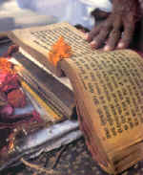
Dev Shastra Guru
Pooja

Slide 87
Dev Shastra Guru Pooja
Pooja can be perform for any Bhagwan or any other entities which are helpful in our spiritual progress.
Dev Shastra Guru Pooja is famous among the jains.
Dev means the Omniscient lord, who preached the jain philosophy and propagated the religion.
Shastra means the literatures created by the disciples of the Omniscient lord.
Guru means the enlightened monks who analyze the vast literatures and explain to us, the mundane souls

Slide 88
Dev Shastra Guru Pooja
In the beginning of Pooja, first we invite the entity to come among us
Then we welcome the entity that we invited
There after the entity is established in the heart.
These 3 events are symbolizes with 3 cloves.
Now we perform the Pooja with 8 auspicious materials.

Slide 89
Dev Shastra Guru Pooja
(Sthapana – To Establish)
Keval Ravi Kirano Se Jiska Sampurna Prakshit He Aantar
Oos Shri Jin Vani Mein Hota Tatvoka Sundar-tum Darshan
Sad Darshan Bodh Charan Path Par Aveeral Jo Badhate Hein Muni-gan
Oon Dev Param Aagam Guru Ko Shat Vandan Shat Vandan

Slide 90
Dev Shastra Guru Pooja
(Sthapana – To Establish)
We have described the nature of Shri Dev Shastra and Guru.

Slide 91
Dev Shastra Guru Pooja
(Sthapana – To Establish)
Om Hrim Dev Shasta Guru Samuh
Atra Avatar Avatar
Samvo Shat
Iti Aahava-hanum
Invitation for Omniscient Lords, Holy Scriptures and Enlightened Monks.

Slide 92
Dev Shastra Guru Pooja
(Sthapana – To Eshtablish)
Om Hrim Dev Shasta Guru Samuh Aatra Tishtha Tishtha
Tha-ha Tha-ha
Iti Stapanum
Welcoming for Omniscient Lords, Holy Scriptures and
Enlightened Monks.

Slide 93
Dev Shastra Guru Pooja
(Sthapana – To Eshtablish)
Om Hrim Dev Shasta Guru Samuh Aatra Mum Sannihito
Bhav Bhav Vashat
Iti Sanni-dhi-karanam
Establishing in the heart for Omniscient Lords, Holy
Scriptures and Enlightened Monks.

Slide 94
Dev Shastra Guru Pooja
Invitation, welcoming and establishing in to our heart is symbolized by offering of 3 cloves.

Slide 95
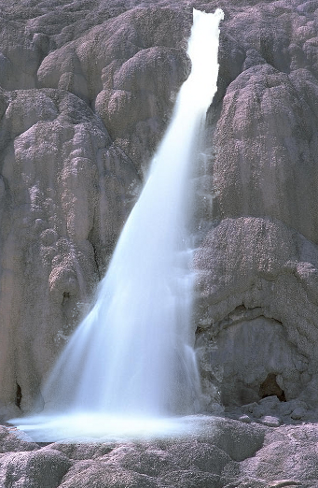
Jal Pooja
Pure Water

Slide 96
Dev Shastra Guru Pooja - #1
(Jal-pooja – Pure Water)
Indriya Ke Bhog Madhur Visha Sam Lavanya Mayi Kanchan Kaya
Yah Sab Kuch Jad-ki Kriya Hai, Mein Aab Tak Jan Naheen Paya
Mein Bhul Svayam Ke Vaibhav Ko Par Mamata Me Atakaya Hoon
Aab Nirmal Samyak Neer Liye Mithya Mal Dhone Aaya Hoon

Slide 97
Dev Shastra Guru Pooja #1
(Jal-pooja – Pure Water)
Om Hrim Dev Shastra Gurubhyo Janma Jara Mrutyu
Vinashnay
Jalam Nirv Pamiti SWAHA

Slide 98
Dev Shastra Guru Pooja #1
(Jal-pooja – Pure Water)
Enlightened and blissful, is my real self.
depicted as clear water.
I wish to eliminate birth and rebirth, to cease the suffering.
On this auspicious day,
I wish to worship Dev Shastra and Guru.
Ohm Rihm Shree Dev Shastra Guru
for the decimation of birth, old age and death
JALAM – NIRVIPAMITI - SWAHA

Slide 99

Chandan Pooja
Sandlewood

Slide 100
Dev Shastra Guru Pooja #2
(Chandan Pooja – Sandlewood water )
Jad Chetan Ki Sab Parinati Prabhu! Apne Apne Meni Hoti Hai
Anukul Kahe Pratikul Kahe, Yas Zuthi Man Ki Vruti Hai
Pratikul Sanyogo Mein Krodhit Hokar Sansar Badhaya Hai
Santapt Raday Prabhu! Chandan Sam, Sitalta Pane Aya Hei.
Mein Bhul Svayam Ke Vaibhav Ko Par Mamata Me Atakaya Hoon
Aab Nirmal Samyak Neer Liyen Mithya Mal Dhone Aaya Hoon

Slide 101
Dev Shastra Guru Pooja - #2
(Chandan Pooj – Sandal Wood)
Om Hrim Dev Shastra Gurubhyo
Sansar Taap Vinashanaya
Chandan Nirvi Pamiti SWAHA

Slide 102
Dev Shastra Guru Pooja - #2
(Chandan Pooj – Sandal Wood)
Pure and permanent, is my real self
depicted as Sandlewood water.
I wish to avoid wandering in trasmigratory cycle, to cease
the suffering.
On this auspicious day, I wish to worship
Dev shastra and Guru
Ohm Rihm Shree Dev Shastra Guru
for the decimation of suffering in trasmigratory Cycle
CHANDANUM– NIRVIPAMITI - SWAHA

Slide 103


Akshat Pooja
Rice

Slide 104
Dev Shastra Guru Pooja - #3
(Akshat Pooja – White Rice)
Ujaval Hun Kunda Dhaval Hun PrabhuParse Na Laga Hun Kinchit Bhi
Phil Bhi Anukul Lage Oon Par Karta Abhiman Nirantar Hi
Jad Par Zuk Zuk Jata Chetan Ki Mardav Ki Khandit Kaya
Nij Shashvat Akshay Nidhi Pane Aab Das Charan Raj Me Aya

Slide 105
Dev Shastra Guru Pooja #3
(Akshat Pooja – White Rice)
Om Hrim Dev Shastra Gurubhyo
Akshay Pad Praptaye
Akshatan Nirvi Pamiti SWAHA

Slide 106
Dev Shastra Guru Pooja #3
(Akshat Pooja – White Rice)
Perfect and eternal, is my real self depicted as white rice
I wish to be liberated, to cease the suffering.
On this auspicious day,
I wish to worship Dev Shastra Guru
Ohm Rihm Shree Dev Shastra Guru
For acquiring ever lasting happiness
AKSHTAM– NIRVIPAMITI - SWAHA

Slide 107
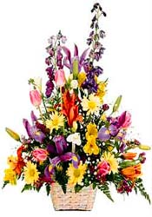
Pushp Pooja
Flower

Slide 108
Dev Shastra Guru Pooja - #4
(Pushpa Pooja - Flower)
यह पुष्प सुकोमल कितना है, तन में माया कुछ शेष नही
निज अंतर का प्रभु भेद काहूँ, औस में ऋजुता का लेश नही
चिन्तन कुछ फिर संभाषण कुछ, वृत्ति कुछ की कुछ होती है
स्थिरता निज में प्रभु पाऊं जो, अंतर का कालुश धोती है
Yah Pushpa Sukomal Kitna Hai Tan-me Maya Kutch Shesh Nahi
Nij Aantar Ka Prabhu Bheda Kahoon Usame Rujuta-ka Lesh Nahi
Chintan Kuchh Phir Sambha Shan Kuchh Vruti Kuchh Ki Kuchh Hoti Hai
Sthirta Nijme Prabhu Pavun Jo Antar Ka Kalush Dhoti Hai

Slide 109
Dev Shastra Guru Pooja - #4
(Pushpa Pooja - Flower)
Om Hrim Dev Shastra Gurubhyo
Kam Ban Vidhvansanay
Pushpam Nirvi Pamiti SWAHA

Slide 110
Dev Shastra Guru Pooja - #4
(Pushpa Pooja - Flower)
Devoid of shape, smell, taste and touch, is my real self
depicted as saffron rice.
I wish to avoid lust and infatuations, to cease the suffering.
On this auspicious day, I wish to worship Dev Shastra
Guru.
Ohm Rihm Shree Dev Shasrta Guru
for the decimation of allure and passions
PUSHPAM– NIRPAMITI - SWAHA

Slide 111

Naivedya Pooja
Rich Food

Slide 112
Dev Shastra Guru Pooja - #5
(Naivedya Pooja – Sweet Food)
अब तक अगणित जड़ द्रव्यों से, प्रभु भूख न मेरी शांत हुई
तृष्णा की खाई खूब भारी, पर रिक्त रही वह रिक्त रही
युग युग से इच्छा सागर में, प्रभु ! गोते खाता आया हूँ
चरणों में व्यंजन अर्पित कर, अनुपम रस पीने आया हूँ
Aab Tak Aganit Jad Drayo Se Prabhu Bhukh Na Meri Shant Huyi
Trushna Ki Khayi Khub Bhari Par Rikta Rahi Vah Rikta Rahi
Yug-yug Se Itchha Sagar Me Prabhu Gote Khata Aaya Hun
Charano Mein Vyanjan Arpit Kar Anupam Ras Pine Aaya Hun

Slide 113
Dev Shastra Guru Pooja - #5
(Naivedya Pooja – Sweet Food)
Om Hrim Shree Dev Shastra Gurubhyo
Kshudha Rog Nivaraya
Naivedyam Nirvi Pamiti SWAHA

Slide 114
Dev Shastra Guru Pooja - #5
(Naivedya Pooja – Sweet Food)
Immaculate and virtuous, is my real self depicted as white
coconut.
I wish to relinquish worldly desires, to cease the suffering.
On this auspicious day
I wish to worship Dev Shastra Guru
Ohm Rihm Shree Dev Shastra Guru
for the decimation of perpetual appetite.
NAIVAIDHYAM– NIRVIPAMITI - SWAHA

Slide 115

Deep Pooja
Flame

Slide 116
Dev Shastra Guru Pooja - #6
(Deep Pooja - Lamp)
मेरे चैत्यन्य सदन में प्रभु! चिर व्याप्त भयंकर अँधियारा
श्रुत दीप बूझा है करुनानिधि, बीती नही कष्टों की कारा
अतएव प्रभो! यह ज्ञान प्रतीक, समर्पित करने आया हूँ
तेरी अंतर लौ से निज अंतर, दीप जलाने आया हूँ।
Mere Chaitanya Sadan Mein Prabhu! Chir Vyapta Bhayankar Andhiyara
Shrut Dip Buza Hai Karunanidhi, Biti Nahi Kaston Ki Kara
Aat Ev Prabho Yah Gnan Pratik Samarpit Karne Aaya Hun
Teri Aanta Lou Se Nij Aantar Deep Jalane Aaya Hun

Slide 117
Dev Shastra Guru Pooja - #6
(Deep Pooja - Lamp)
Om Hrim Dev Shastra Gurubhyo
Agnan-andhkar Vinash Nayam
Deepam Nirvi Pamiti SWAHA

Slide 118
Dev Shastra Guru Pooja - #6
(Deep Pooja - Lamp)
Omniscient knowledge, is my real self, depicted as saffron
coconut.
I wish to decimate wrong perception, to cease the suffering.
On this auspicious day
I wish to worship Dev Shastra Guru
Ohm Rihm Shree Dev Shastra Guru
for illumination of true knowledge
DEEPAM– NIRPAMITI - SWAHA

Slide 119

Dhoop Pooja
Incense

Slide 120
Dev Shastra Guru Pooja - #7
(Dhoop Pooja - Incense)
जड़ कर्म घुमाता है मुझको, यह मिथ्या भ्रांति रही मेरी
में रागी द्वेषी हो लेता, जब परिणति होती है जड़ कीरी
यों भाव करम या भाव मरण, सदिओं से करता आया हूँ
निज अनुपम गंध अनल से प्रभु, पर गंध जलाने आया हूँ
Jad Karma Ghumata He Muj Ko Yah Mithya Bhranti Rahi Meri
Mein Ragi Dweshi Ho Leta Jab Parinati Hoti Jad Keri
Yon Bhav Karam Ya Bhav Maran Sadiyon Se Karata Aaya Hun
Nij Anupam Gandh Analase Prabhu Par Gandh Jalane Aaya Hun

Slide 121
Dev Shastra Guru Pooja - #7
(Dhoop Pooja - Incense)
Om Hrim Dev Shastra Gurubhyo
Vibhav Parinati Vinash Nayam
Dhoopam Nirvi Pamiti SWAHA

Slide 122
Dev Shastra Guru Pooja - #7
(Dhoop Pooja - Incense)
Devoid of any karmic particles, is my real soul depicted as
Incense.
I wish to destroy all destructive and non destructive karma,
to cease the suffering.
On this auspicious day
I wish to worship Dev Shastra Guru
Ohm Rihm Shree Dev Shastra Guru
for the decimation of all karmic particles
DHUPAM– NIRPAMITI - SWAHA

Slide 123

Phal Pooja
Fruit

Slide 124
Dev Shastra Guru Pooja - #8
(Phal Pooja - Fruit)
जग में जिसको निज कहता में, वह छोड मुझे चल देता है
में आकुल व्याकुल हो लेता, व्याकुल का फल व्याकुलता है
में शांत निराकुल चेतन हूँ, है मुक्तिरमा सहचर मेरी
यह मोह तड़क कर टूट पड़े, प्रभु सार्थक फल पूजा तेरी
Jag Me Jisko Nij Kahta Mein Vah Chhod Muje Chal Deta Hein
Mein Akul Vyakul Ho Leta Vyakul Ka Phal Vyakulta Hai
Mein Shant Nirakul Chetan Hun Hai Mukti-rama Sah Char Meri
Yah Moh Tadak Kar Tut Pade Prabhu Sarthak Phal Pooja Meri

Slide 125
Dev Shastra Guru Pooja - #8
(Phal Pooja - Fruit)
Om Hrim Dev Shastra Gurubhyo
Moksha Phal Praptaye
Phalam Nirvi Pamiti SWAHA

Slide 126
Dev Shastra Guru Pooja - #8
(Phal Pooja - Fruit)
Immortal is my real self depicted as almond.
I wish to achieve eight virtues of Siddha
to reach Siddhahood.
On this auspicious day
I wish to worship Dev Shastra Guru
Ohm Rihm Shree Dev Shastra Guru
for attaining MOKSHA
PHALAM– NIRPAMITI - SWAHA

Slide 127

Argh Pooja
All Eight Substances

Slide 128
(Aargh Pooja – All 8 Substances Together)
क्षण भर निज रस को पी चेतन, मिथ्यमल को धो देता है
कशायिक भाव विनष्ट किये, निज आनन्द अमृत पीता है
अनुपम सुख तब विलसित होता, केवल रवि जगमग करता है
दर्शन बल पूर्ण प्रगट होता, यह है अर्हन्त अवस्था है
यह अर्घ्य समर्पण करके प्रभु, निज गुण का अर्घ्य बनाऊंगा
निश्चित तेरे सदृश प्रभु, अर्हन्त अवस्था पाउंगा
Kshana Bhar Nij Rasko Pee Chetan Mithya Mal Ko Dho Deta He
Kasha-yik Bhav Vinashta Kiye Nij Anand Amrut Pita Hai
Anupam Sukh Tab Vilsit Hota Keval Ravi Zagmag Karta Hai
Darshan Bal Purna Pragat Hota Yah Hi Arhant Avastha Hai
Yah Aargh Samarpan Karke Prabhu Nij Gun Ka Argh Banaunga
Aur Nishchit Tere Sadashya Prabhu Arhant Avastha Paunga

Slide 129
Aargh Pooja
All 8 Substances Together
Om Hrim Dev Shastra Gurubhyo
Anargha Pad Praptaye
Aargham Nirvi Pamiti SWAHA

Slide 130
Aargh Pooja
All 8 Substances Together
Epitome of perfection, is my real self
depicted by all eight substances
I wish to cultivate infinite qualities to achieve MOKSHA
On this auspicious day
I wish to worship Dev Shastra Guru
Ohm Rihm Shree Dev Shastra Guru
For liberating my soul
ARGHYAM– NIRPAMITI - SWAHA

Slide 131
Jaymala
At the end of any Pooja with offerings of 8 material substances, we now show our respect by praising their virtues. This is called Jaymala.
In our present Pooja, the Jaymala is unique. It praises the virtues of Dev, Shastra and Guru. In addition it also mentions the 12 contemplations. They are very important for an aspirant soul.

Slide 132
Jaymala
भव वन में जी भर घूम चुका, कण कण को जी भर भर देखा।
मृग सम मृग तृष्णा के पीछे, मुझको न मिली सच की रखा।
Bhav Van Me Ji Bhar Ghum Chuka Kan Kan Ko Ji Bhar Bhar Dekha
Mrug Sam Mrug Trushna Ke PiChhe Mujko Na Mili Sukh Ki Rekha
I kept looking for happiness in worldly material things. But it is a
mirage. I did not find the peace.

Slide 133
Jaymala
Anitya Bhavana
Transitoryness Contemplation:
झूठे जग के सपने सारे, झूठी मन की सब आशाएं ।
तन जीवन यौवन अस्थिर है, क्षण भंगुर पल में मुरझाएं ।
Juthe Jagake Sapne Sare Juthi Man Ki Saba Ashaye
Tan Jivan Youvana Asthira He Kshana Bhangur Palame Murjaye
Every thing around us like expectations, the youth,
the body etc. are transient just like a dream.

Slide 134
Jaymala
Ashrana Bhavana
Helplessness Contemplation:
सम्राट महाबल सेनानी, उस क्षण को टाल सकेगा क्या।
अशरण मृत काया में हरषित, निज जीवन दल सकेगा क्या।
Samrat Mahabal Senani Ush Kshan Ko Tal Sakega Kya
Asharana Mruta Kayame Harshit Nij Jivan Dal Sakega Kya
Even the great king will not be able to bring the life in dead
body.

Slide 135
Jaymala
Sansar Bhavana
Transmigratoryness Contemplation:
संसार महा दुख सागर के, प्रभु दुखमय सुख आभसोन में।
मुझको न मिला सुख क्षणभर भी, कंचन कामिनी प्रासदोन में।
Sansar Maha Dukh Sagar Ke Prabhu Dukha Maya Sukha Abhaso Me
Mujko No Mila Sukh Kshan Bharabhi Kanchan Kamini Prasado Me
For time infinite I am in the life and death cycle. I am tired
of it now. I did not get peace in material wealth or spouse. I
want everlasting peace.

Slide 136
Jaymala
Ekatva Bhavana
Loneliness Contemplation:
में एकाकी एकत्वा लिये, एकत्वा लिये सब है आते।
तन धन को साथी समझा था, पर ये भी छोड चले जाते।
Mei Ekaki Ekatva Liye Ekatwa Liye Sabahi Ate
Tan Dhan Ko Sathi Samjatha Par Ye Bhi Choda Chale Jate
I came alone and will go alone. My body, money etc. do not
come with me.

Slide 137
Jaymala
Anyatva Bhavana
Separateness Contemplation:
मेरे न हुए ये में इनसे, अति भिन्ना अखंड निराला हूँ।
निज में पर से अन्यत्वा लिये, निज समरस पीने वाला हूँ।
Mere Na Hue Ye Me Inse Ati Bhinn Akhand Nirala Hu
Nij Me Parse Anyatva Liye Nij Sam Rasa Pine Vala Hu
My soul is separate from every thing around me, including
my own body. I indulge in my soul’s inner happiness.

Slide 138
Jaymala
Asuchi Bhavana
Impurity Contempletion:
जिसके श्रिन्गारोन में मेरा, यह महंगा जीवन घुल जाता।
अत्यन्त अशुचि जड़ काया से, ईस चेतन का कैसा नाता।
Jiske Shrunga Ro Me Mera Yah Mahanga Jivan Ghul Jata
Atyanta Asuchi Jada Kaya Se Is Chetan Ka Kaisa Nata
This body that I love is full of impurities. Why should I love
it so much? My soul has no inherent relationship with body.

Slide 139
Jaymala
Asrav Bhavana
Inflow of Karma Contemplation:
दिन रात शुभाशुभ भावों से, मेरा व्यापार चला करता।
मानस वाणी और काया से, आस्रव का द्वार खुला रहता।
Din Rat Subha Shubha Bhavo Se Mera Vyapar Chala Karta
Manas Vani or Kaya Se Asrav Ka Dvar Khula Rahata
By auspicious and inauspicious sentiments, I keep on
acquiring karma to my soul through mind, speech and action.

Slide 140
Jaymala
Sanvar Bhavana
Stoppage of karma Contemplation:
शुभ और अशुभ की ज्वाला से, झुलसा है मेरा अन्तस्तल।
शीतल समकित किरण फूटें, सँवर से जाग अन्तर्बल।
Subh or Ashubh Ki Jwala Se Julsa He Mera Antahstal
Shital Samakit Kirane Fute Samvar Se Jage Antar Bal
With auspicious and inauspicious sentiments, my soul is
burning. By acquiring the enlightened faith, I can stop the
fire of those sentiments.

Slide 141
Jaymala
Nirjara Bhavana
Shedding of Karma Contemplation:
फिर तप की शोधक वन्हि जगे, कर्मों की कड़ियाँ फूट पड़ें ।
सर्वांग निजात्म प्रदेशों से, अमृत के निर्झर फूट पड़ें
Fir Tap Ki Sodhaka Vahi Jage Karmo Ki Kadiya Tut Pade
Sarvang Nijatma Prade Sonse Amrut Ke Nirzar Fut Pade
With the enlightened faith, now I will do 12 types penances.
(Tap) My karma will start shedding quickly. My soul will
have inner happiness.

Slide 142
Jaymala
Lok Bhavana
Contemplation About the Universe:
हम छोड चलें यह लोक तभी, लोकान्त विराजें क्षण में जा।
निज लोक हमारा वासा हो, शोकान्त बनें फिर हमको क्या।
Hum Chhod Chale Yah Lok Tabhi Lokanta Viraje Kshana Me Ja
Nij Loka Hamara Vasa Ho Sokanta Bane Fir Humko Kya?
One start contemplation of the universe and truly believes that
my own universe is within me.

Slide 143
Jaymala
Bodhi Durlabha Bhavana
Enlightened Contemplation:
जागे मम दुर्लभ बोधी प्रभो, दुर्नैतम सत्वर तल जावे।
बस ज्ञाता दृष्टा रह जाऊं, मद मत्सर मोह विनश जावे।
Jage Mumu Durlabha Bodhi Prabho Dur Naya Tam Satwar Tal Jave
Bas Gnata Drasta Rah Jawu Maad Matsara Moh Vinas Jave
Now with enlightened faith, I am the knower of my soul and the
whole universe. I am not doer of anything but my pure soul.

Slide 144
Jaymala
Dharma Bhavana
Contemplation of Omniscient’s Path:
चिर रक्षक धर्म हमारा हो, हो धर्म हमारा चिर साथी।
जग में न हमारा कोई था, हम भी न रहें जग के साथी।
Chir RakshaKa Dharma Hamara Ho Ho Dharma Hamara Chir Sathi
Jaga Me Na Hamara Koi Tha Ham Bhi Na Rahe Jag Ke Sathi
Omniscient has shown the path of liberation. I have utmost
confidence in it. All the relationships of the universal
substances are transient in nature.

Slide 145
Jaymala
Nature of the Omniscient Lord
चरणों में आया हूँ प्रभुवर, शीतलता मुझको मिल जावे।
मुरझाई ज्ञानलता मेरी, निज अन्तर्बल से खिल जावे।
Charano Me Aya Hu Prabhuvar Shital Ta Mujko Milajave
Murzayi Gnan Lata Meri Nija Antara Balase Khila Jave
Oh Lord, I came to your feet now and I get real peace of
mind. My knowledge attribute shines with my inner
strength.

Slide 146
Jaymala
Nature of the Omniscient Lord
सोचा करता हूँ भोगों से, बूझ जावेगी इच्छा ज्वाला।
परिणाम निकलता है लेकिन, मानो पावक में घी डाला।
Sochar Karta Hu Bhogo Se Buza Javegi Ichha Jwala
Parinam Nikala Ta He Lekin Manov Pavak Me Ghee Dala
Oh Lord! I thought that by satisfying the desires, they will go away. Instead I end up with lot more desires.

Slide 147
Jaymala
Nature of the Omniscient Lord
Tere Charano Ki Puja Se Indriya Sukha Ko Hi Abhilasha
Aba Taka Na Samaj Hi Paya Prabhu Sat Che Suka Ki Bhi Pari Bhasha
Until now I did not understand the real nature of happiness.
I kept on wishing the pleasures of worldly material things.
Now that I came to take worship You, I do understand the
real nature of happiness.

Slide 148
Jaymala
Nature of the Omniscient Lord
Tumto Avikari Ho Prabhuvar Jagame Rahate Jagase Nyare
Ata Avuh Zuke Tava Charano Me Jaga Ke Manik Moti Sare
Oh Lord! You are passionless. You are in the universe but
are totally separate from material things. All the material
things are worthless at Your divine feet.

Slide 149
Jaymala
Nature of the scriptures
Syada Vada Mayi Teri Vani Subha Nayake Zarane Zarate He
Usa Pavana Nauka Par Lakho Prani Bhava Varidhi Tira Te Hein
Your scriptures are loaded with multiplicity point of views. One
who understands this, is on the path of liberation.

Slide 150
Jaymala
Nature of Guru
He Guruvar Sashvat Shuka Darshak Yaha Nagna Swarup Tumhara Hein
Jagaki Narshwar Taka Sachha Diga Darshan Karne Vala Hein
Gurudev, you are the replica of permanent happiness coming
from within. You are without any external attachments of
clothes etc. You show us the real nature of the universe and
the soul.

Slide 151
Jaymala
Nature of Guru
Jab Jag Visayo Me Racha Pacha Kar Gafil Nindra Me Sota Ho
Athava Vah Shiv Ke Nishkantak Patha Me Vishakantak Botaho
The transmigratory soul is involved in the objects of five senses
or he may be throwing thorns on the path way of the monks. But
the monk is not moved by this unfavorable situation.

Slide 152
Jaymala
Nature of Guru
Ho Ardha Nishaka Sannata Vana Me Vana Chari Charte Ho
Taba Santa Nirakul Manas Tuma Tatvo Ka Chintan Karte Ho
When there is night in jungle, all the violent animals are
roaming around, the monk is staying in meditative posture and
is deeply reflecting up on his pure nature of the soul.

Slide 153
Jaymala
Nature of Guru
Karte Tap Shail Nadi Tat Par Taru Tal Varshaki Jadiyo Mein
Samata Ras Pan KIya Karte Sukh Dukh Dono Ki Gadhiyo Mein
Monk is performing his austerity at the bank of a river or under a
tree when it is raining. He is unmoved by external surrounding
and is in equanimity state.

Slide 154
Jaymala
Nature of Guru
Antar Jwala Harati Vani Mano Jarati Ho Phool JAdiyana
Bhav Bandhana Tad Tad Tut Pade Khila Jave Antara Ki Kaliya
With the preaching of the monk, one’s internal state cools down
and all the karmic bondage starts breaking down and one
obtains the peace from experiencing his pure nature of the
soul.

Slide 155
Jaymala
Nature of Guru
Tum Sa Dani Kya Koi Ho Jaga Ko Dedi Jaga Ki Nidhiya
Din Rat Lutaya Karate Ho Sama Shama Ki Avinasvar Maniya
Oh Monk! You are the great gift giver. You already donated
all material things and now you are spreading the real
knowledge of the nature of the pure soul.

Slide 156
Argh
Ohm Rihm Shree Dev Shastra Gurubhyo
Anargh Pad Praptaye Argham Nirvipamite Swaha
(Offering of all eight substances)

Slide 157
Argh
Epitome of perfection, is my real self
depicted by all eight substances
I wish to cultivate infinite qualities to achieve MOKSHA
On this auspicious day
I wish to worship Dev Shastra Guru
Ohm Rihm Shree Dev Shastra Guru
For liberating my soul
ARGHYAM– NIRPAMITI - SWAHA

Slide 158
Jaymala
Hey Niramal Dev Tumhe Pranam Hey Gnan Deep Agam Pranam
Hey Shanti Tyag Ke Murtiman Shiv Path Panthi Guruvar Pranam
(Iti Puspanjali Kshipet).
Omniscient Lord, Holy Scriptures and the Enlightened Monks, I
sincerely bow down to you all.
(Offering of yellow rice).

Slide 159
Rushabhdev Argh
Rushabhdev Bhagwan’s Argh
Suchi Nirmal Niram Gandh Suakshat, Pusp Charu Le Man Harshay
Deep, Dhup Phal Arghya Su Lekar, Nachat Tal Mrudang Bajay
Shree Adinath Ke Charan Kamal Par Bali Bali Jaun Man Vach Kaya
He Karunanidhi ! Bhav Dukh Meto, Yatei Mein Puju Prabhu Pay!
Ohm Rihm Shree Adhinath Jinendrayay Anardhya Pad Praptaye Argham Nirvipamite Swaha

Slide 160
Mahavir Swami Argh
Shree Mahavir Swami Argh
Ish Arghya Ka Kya Mulya Hai Ana ardhya Pad Ke Samane?
Ush Param Pad Ko Pa Liya He Patit Pavan Apne
Santapt Manas Shant Ho Jinke Guno Ke Gan Mein
Ve Vardhaman Mahan Jin Vichare Hamare Dhyan Mein
Ohm Rihm Shree Vardhaman Jinendraraya Anardhya Pad Praptaye
Arghyam Nirvipamite Swaha

Slide 161
24 Tirthankars Argh
Twenty Four Tirthankars Argh
Jal Phal Andho Suchi sar Tako Arghya Karo
Tumko Arpon Bhavtar, Bhav Tari Moksah Varon
Chovisho Shree Jin Chand, Anand Kand Sahi
Pad Jajat Harat Bhav Fand, Pavat Moksha Mahi
Ohm Rihm Shree Vrushabhadi Virantebhyo
Anarghya Pad Praptaye, Arghyam Nirvipamite Swaha

Slide 162
Samuchhaya Argh
Me Deva Shri Arahant Puju Siddha Puju Chava So
Acharya Shri Uvajaya Puju Sadhu Puju Bhava So
I worship with utmost care to all five supreme beings. They
are Arihant, Siddha, Acharya, Upadhyaya and Sadhu

Slide 163
Samuchhaya Argh
Arahant Bhashita Vayin Puju Dwada Sanga Rache Gani
Puju Digambar Guru Charana Shiva Heta Sab Asha Hani
I worship the Holy Scriptures as narrated by Omniscient Lords. I also worship Enlightened Monks, who show me the path of internal happiness.

Slide 164
Samuchhaya Argh
Sarvagna Bhashita Dharma Dashavidhi Daya Maya Puju Sada
Jaji Bhavana Shodus Ratana Treya Javina Shiva Nahi Kada
I worship religion of ten virtues as well as sixteen spiritual
reflections as narrated by Omniscient Lords.

Slide 165
Samuchhaya Argh
Trey Log Kyake Krutrim Akrutrim Cheytya Cheytyala Jaju
Panchameru Nandiswara Jina Laya Khachara Sura Pujita Bhaju
I worship all the eternal and non eternal temples of the universe.
I also worship the eternal temples related to five Meru mountains
and Nandiswar Dwip.

Slide 166
Samuchhaya Argh
Kailas Shri Samed Shri Giranar Giri Puju Sada
Champapuri Pawa Puri Puni Aur Tirath Sarvada
I worship five Nirvana places. They are Kailash, Sammedgiri, Girnar, Champapuri and Pavapuri.

Slide 167
Samuchhaya Argh
Chovis Shri Jinaraj Puju Bis Kshetra Videha Ke
Nama Vali Ika Sahasa Vasu Jaya Hoya Prati Siva Geh Ke
I worship 24 Tirthankars of this time cycle and also twenty Tirthankaras of area of Videh.

Slide 168
Samuchhaya Argh
Jala Ghandha Kshata Pushpa Charu Dipa Phool Phal Lai
Sarva Pujya Pada Puja Hu Bhahu Vidhi Bhakti Badhaya
Pure water, sandlewood, rice, flower, rich food, flame,
incense and fruits- with all these eight substances I offer
my gratitude to all the essential entities of the universe
which help me achieve liberation.

Slide 170
Shanti Path
Peace Prayer

Slide 171
Shanti path
Shastrokt Vidhi Pooja Mahotsava, Surpati Chakri Kare
Hum Sarikhe Laghu Purush Kaise, Yatha Vidhi Pooja Kare
Heavenly angels perform the pooja with proper
scriptural way. I am an average human being and
do not know how to perform pooja properly.

Slide 172
Shanti path
Dhan Kriya Gnan Rahit Na Jane, Rit Poojan Nathaji
Hum Bhakti Vash Tum Charan Aage Jod Line Hathji
Oh God! I may not have wealth, knowledge or
proper procedure to perform pooja. But I am doing
all these things with devotion towards You.
I bow down to You.

Slide 173
Shanti path
Dukh Haran Mangal Karan Asha Bharan Jin Pooja Sahi
Yah chitt Mein Shraddhan Mere, Shakti Hei Swayamev Hi
I strongly believe that performing the act of worshiping
removes the misery and it is an auspicious act. That is why I
perform the pooja with my own inner strength.

Slide 174
Shanti path
Tum Sarikhe Datar Paye, Kaj Laghu Jachu Kaha
Muz Aap Sam Kar Lehu Swami, Yahi Ik Vanchha Maha
Oh God! You are a great donator. By worshiping you, I have
only one desire. I wish You make me like You.

Slide 175
Shanti path
Sansar Bhishan Vipin Mein, Vasu Karm Mil Atapiyo
Tis Dahtai Akulit Chiratei, Shanti Thal Kahu Na Liyo
Oh Lord! In the life and death cycle, I am burning with
Fruition of eight karma. They disturb my mind and make
me confused. I do not see any place of peace and quietness

Slide 176
Shanti path
Tum Mile Shanti Swarup, Shanti Sukaran Samarath Jagpati
Vasu Karma Mere Shanti Kar Do, Shantimay Panchamgati
Oh Lord! In this difficult time, I met You. You are full of peace
and quietness and You are the king of the universe. I urge
You to give me strength so that I can destroy all my
karma and obtain liberated state, just like You.

Slide 177
Shanti path
Jablau Nahi Shiv Lahu, Tablau Deh Yah Nar Pavana
Satsang Suddha Charan Shrut Abhyas Atam Bhavana
Oh Lord! till I obtain nirvana, I wish to become human
being again and again and wish to have company of
Noble persons. I wish to study scriptures in detail and
put them in to action and wish to stay within my nature
of the soul.

Slide 178
Shanti path
Tum Been Anantant kaal Gayo Rulat Jagjal Mein
Ab Sharan Aayo Naath Yug Kar Jor Naavat Bhaal Mein
Oh Lord! Without You I wandered in the universe without
any directions and wasted my time. Now I am taking
refuge at your divine feet. I bow down to You.

Slide 179
Shanti path
Kar Praman Ke Maan Tein, Gagan Napei Kihi Bhant
Tyon Tum Gun Varnan Karat, Kavi Pave Nahi Ant.
The poet is describing Your infinite attributes.
There is no end to Your praises.

Slide 180
Visharjan
(Ending Part of the Pooja
Recite 9 times)
णमो अरिहंताणं णमो सिद्धाणं
णमो आयरियाणं णमो उवज्झायाणं
णमो लोए सव्व साहूणं
एसो पंच णमोक्कारो, सव्व पावप्प णासणो
मंगलाणं च सव्वेसिं, पडमम हवई मंगलं
Namo Arihantanam Namo Siddhanam
Namo Ayariyanum Namo Uwajayanum
Namo Lowe Sava Sahunum
Eso Pancha Namukkaro Savva Pawa Pannasano
Mangala Luncha Savve Sim Paddamam Havvei Mangalam

Slide 181
Visharjan
(Ending Part of the Pooja)
Bin Jaane Va Janke Rahee Toot Jo Koi
Tum Prasad Tein Param Guru So Sab Pooran Hoyee
Oh Lord! Unknowingly, I may have made mistake during
Pooja. Please forgive me for that.

Slide 182
Visharjan
(Ending Part of the Pooja)
Poojan Vidhi Jano Naheen Naheen Jano Ahavan
Aur Visharjan Hoon Naheen Kshma Karo Bhagvan
I may not be knowing the true nature of performing pooja.
So I may have made mistake unknowingly. I sincerely
asking for forgiveness.

Slide 183
Visharjan
(Ending Part of the Pooja)
Manta-hin Dhan-hin Hoon Kriya-hin Jin Dev
Kshma Karahoon Raakhhoo Muje Dehoon Charanki Sev
Oh Lord! I may have made mistake in pronunciation of
verses or may not have performed the ritual in right
manner. Please Lord, forgive me and grant me permission
to stay at Your lotus feet.

Slide 184
Jai Jinendra
The End

