Slide 1
Read / पठ् / paTh
Person / पुरुष / puruSha | Number / वचन / vachana
 | Singular एकवचन / ekavachana | Dual द्वीवचन / dviivachana | Plural बहुवचन / bahuvachana
Third प्रथम / prathama | पठति / paThati (is reading) | पठतः / paThataH (both are reading) | पठन्ति / paThanti (many are reading)
Second मध्यम / madhyama | पठसि / paThasi (you are reading) | पठथः / paThathaH (you two are reading) | पठथ / paThatha (you all reading)
First उत्तम / uttama | पठामि / paThaami (i am reading) | पठावः / paThaavaH (both of us reading) | पठामः / paThaamaH (all of us reading)

Slide 2
              Gender
Masculine Feminine Neuter | पुलिङ्ग स्त्रीलिङ्ग नपुङ्सकलिन्ग

Slide 3
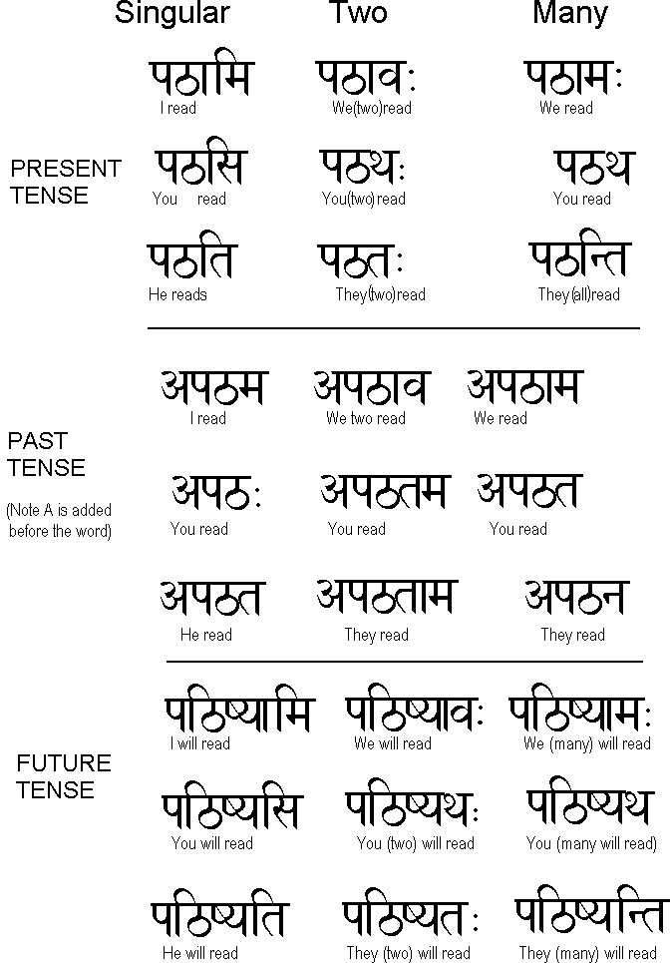

Slide 4
In Sanskrit:
Subject is called -> कर्ता / kartaa
Object is called -> कर्म / karma
Verb is called -> क्रिया / kriyaa

Slide 5
Verb or धातु (dhaatu) has 10 different forms known as लकार (lakaara) and they are listed below.
लट्लकार / laTlakaara
लृट्लकार / lRRiTlakaara
लङ्लकार / laN^lakaara
आझयांलोट्लकार / aajhaayaa.nloTlakaara
विधैलिङ्लकार / vidhailiN^lakaara
लिट्लकार / liTlakaara
लुट्लकार / lRRiTlakaara
आशीलिङ्लकार / aashiiliN^lakaara
लुङ्लकार / luN^lakaara
लृङ्लकार / lRRiN^lakaara

